Slide 1
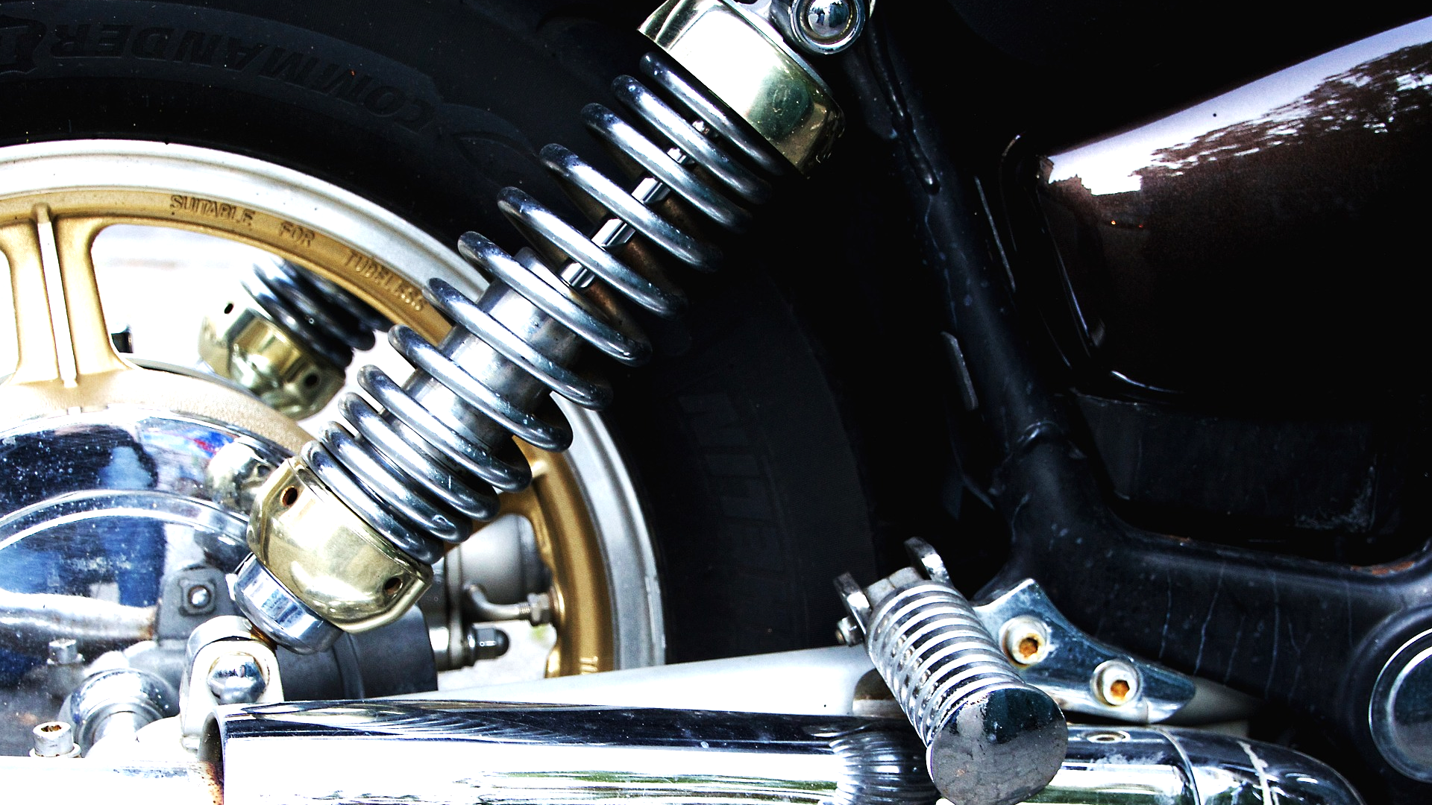
Optimal Control
of
Active Suspension
Ajinkya Jain and Soovadeep Bakshi

Slide 2
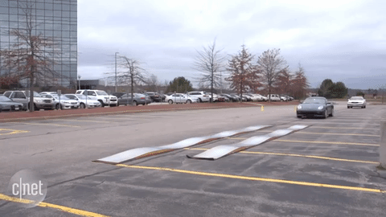
Motivation

Slide 3
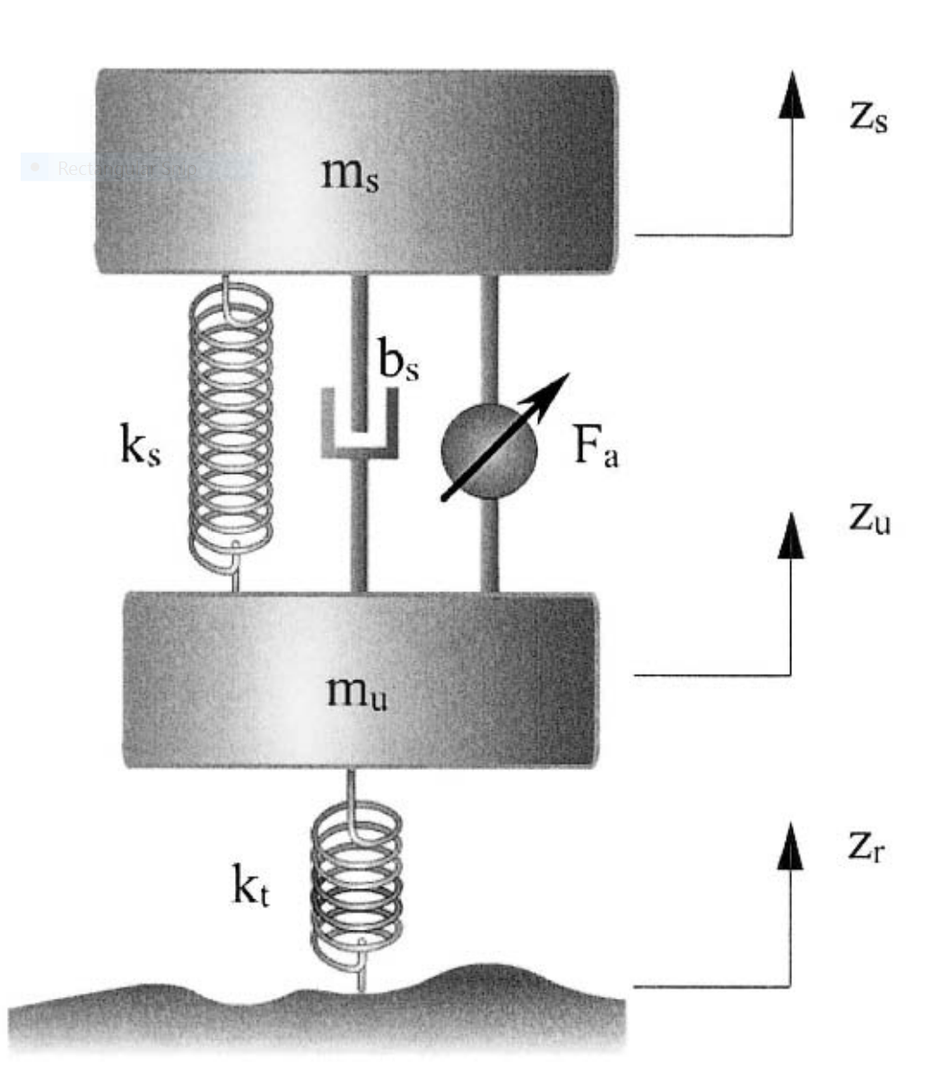
Introduction: Physical System
Quarter Car Suspension Model:
Rajamani, Rajesh. Vehicle Dynamics And Control. 1st ed. Springer, 2014.
Notes:
All deflections are absolute

Slide 4
Physical System
System Parameters:
Sprung Mass:
Unsprung Mass:
Suspension Stiffness
Suspension Damping
Tire Stiffness
The tire damping is generally small (~10 Ns/m), and is therefore neglected!
Wong, J. (2008). Theory of Ground Vehicles. Hoboken, NJ: John Wiley & Sons.

Slide 5

System Modeling
Fourth order system
State-Space representation:
Suspension Deflection
Sprung Mass Velocity
Tire Deflection
Unsprung Mass Velocity

Slide 6

System Modeling

Slide 7

Controllability
Rank = 4: Controllable!

Slide 8


Observability
Rank = 4: Observable!

Slide 9


Stability Analysis
Characteristic Equation:
Stability Conditions: Routh-Hurwitz Criterion
System BIBO Stable!

Slide 10
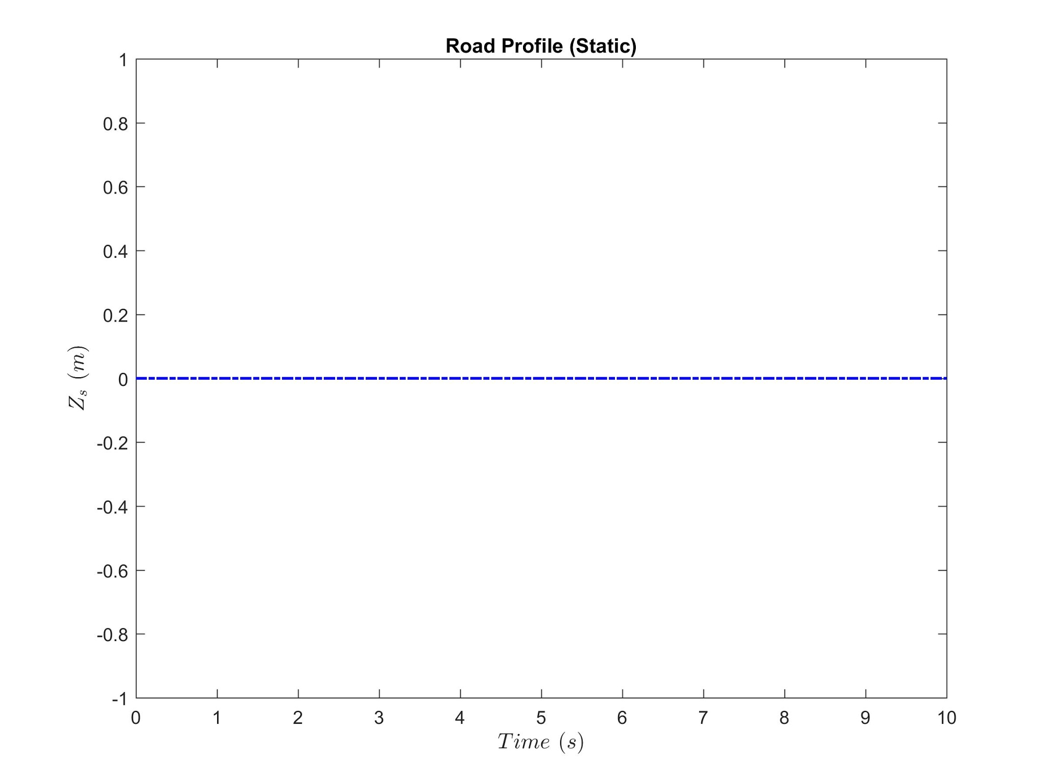
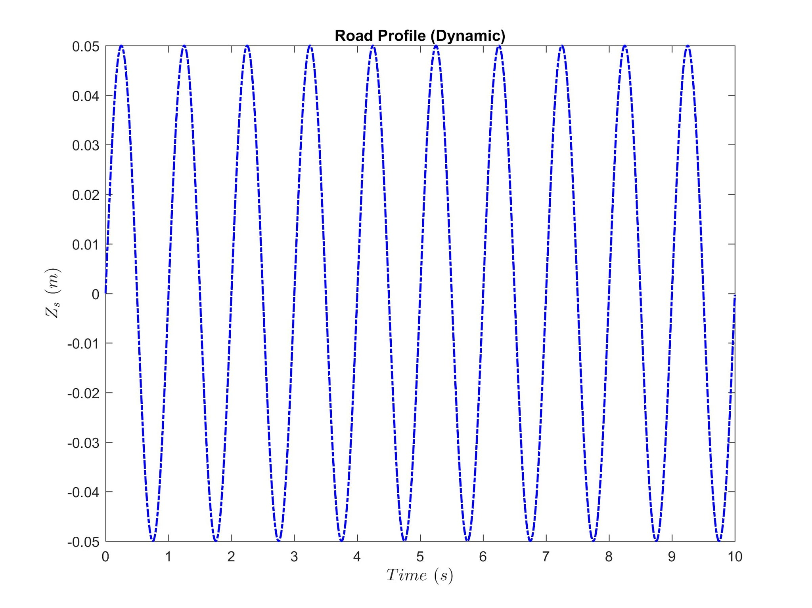
Passive System Analysis
Input Road Profiles:

Slide 11
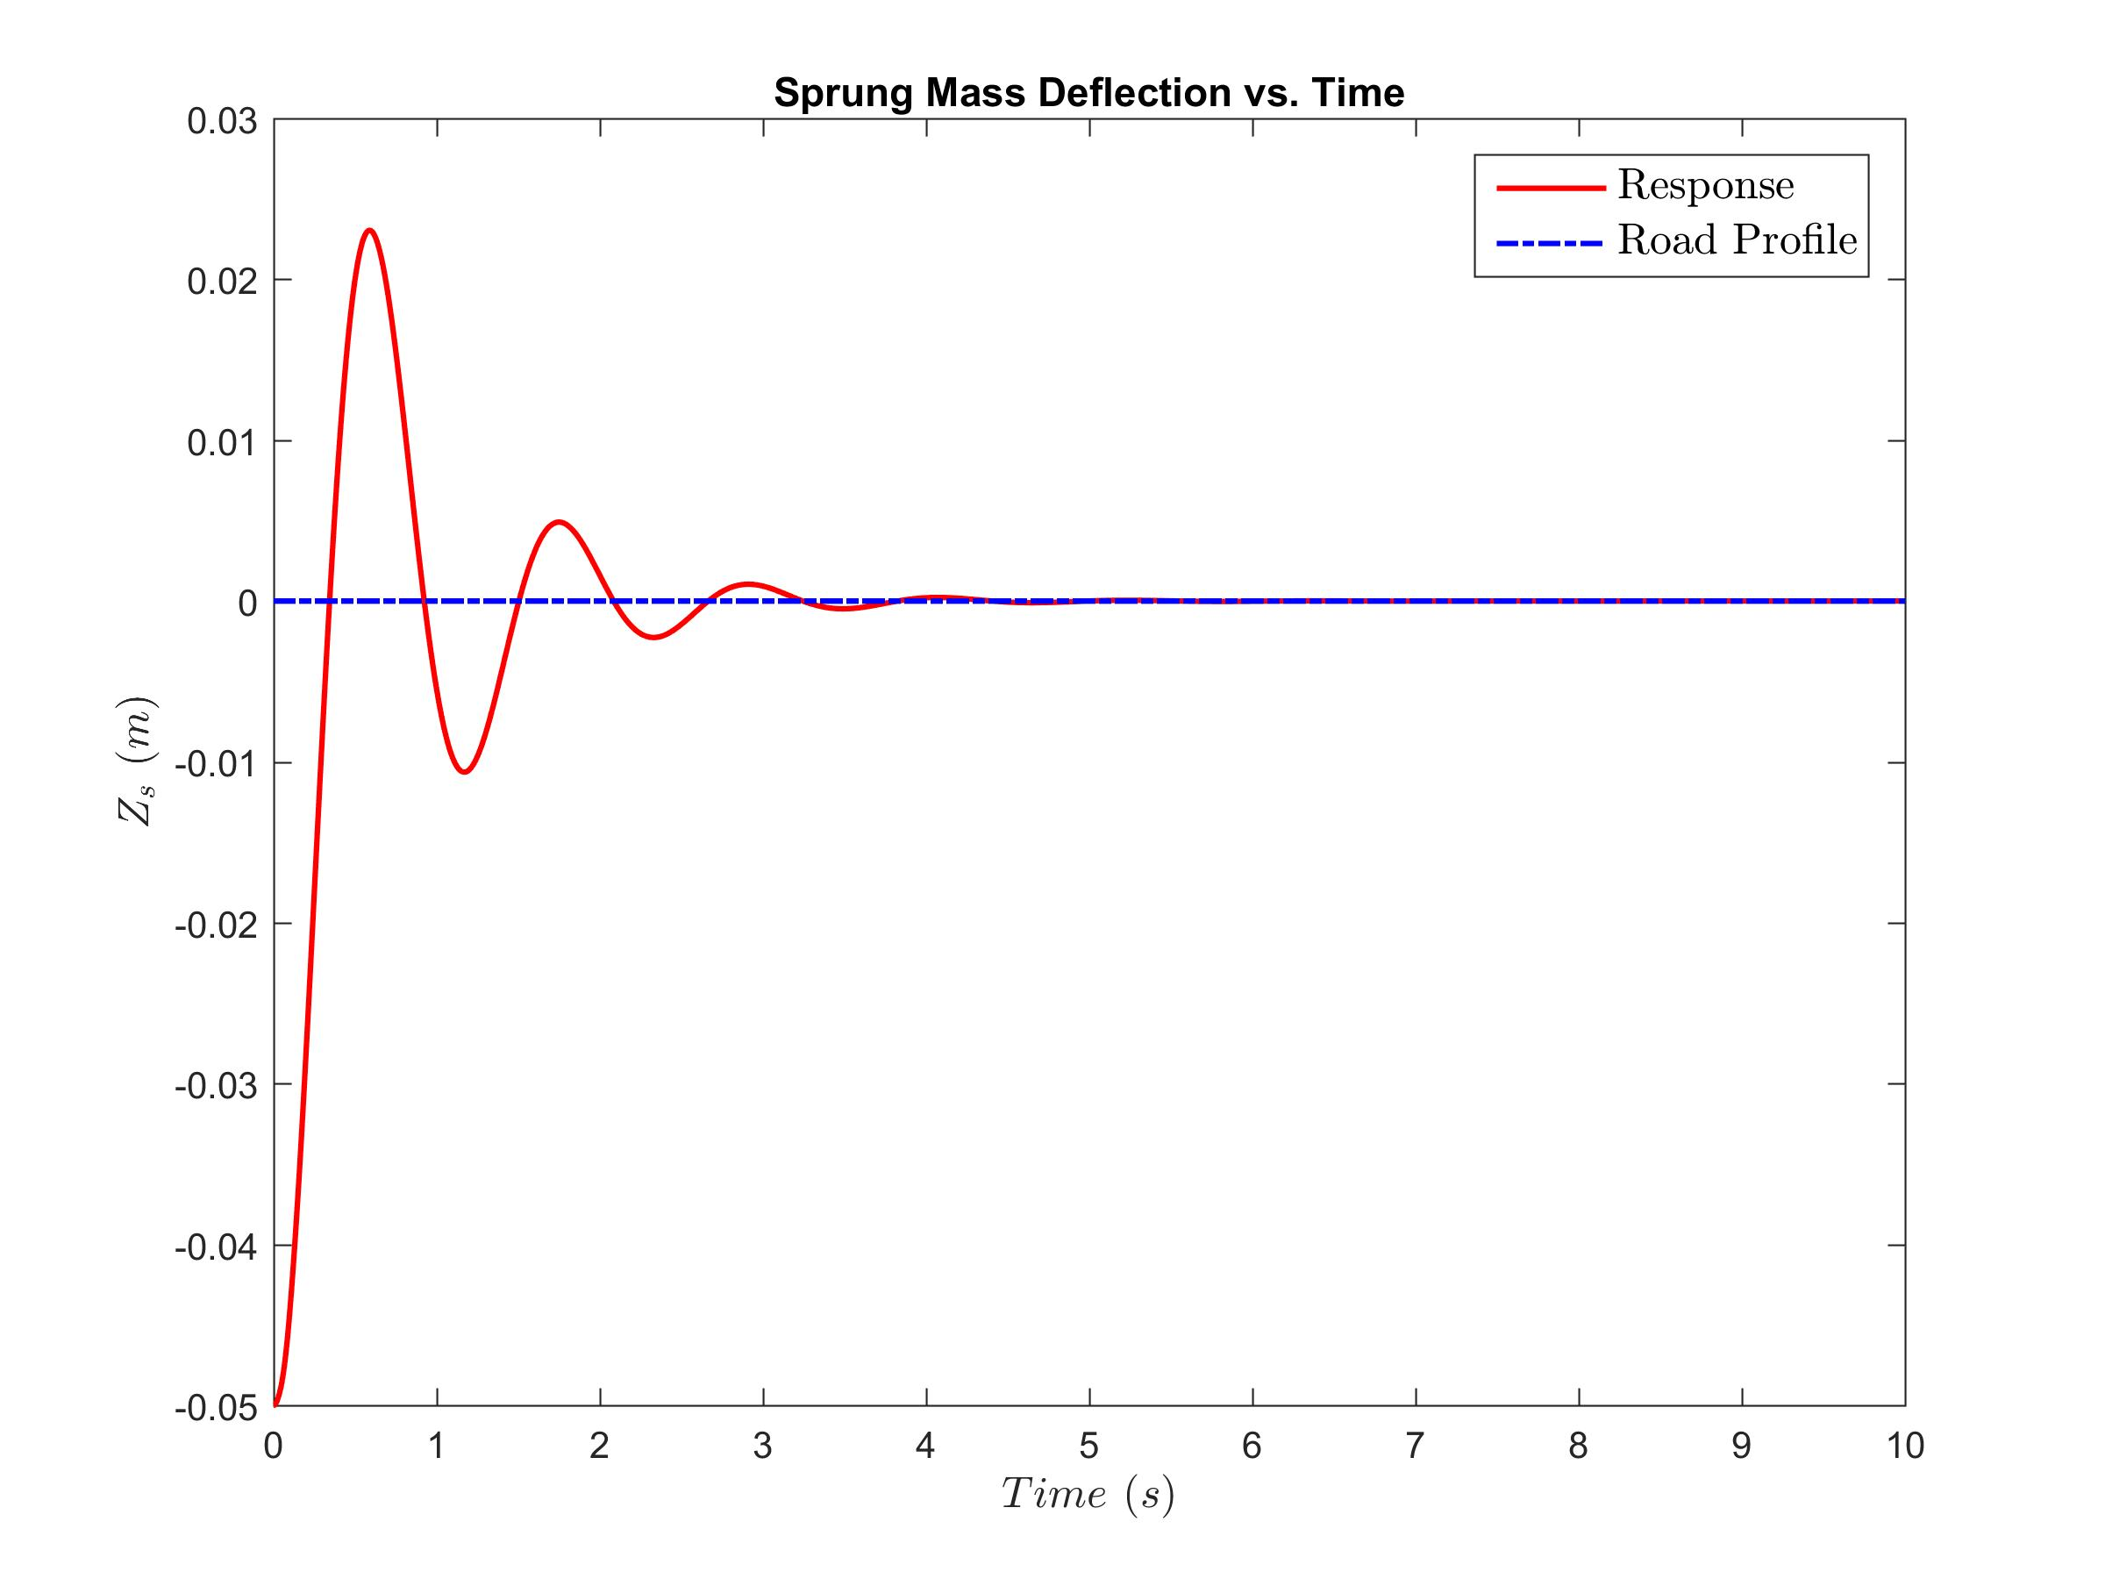
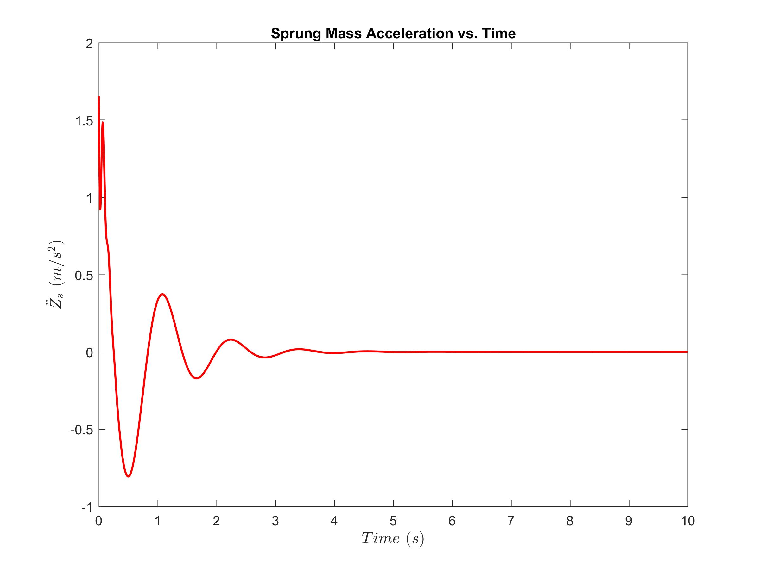
Passive System Analysis
Static Input: Flat Road
Notes:
Human body feels only acceleration and not velocities

Slide 12
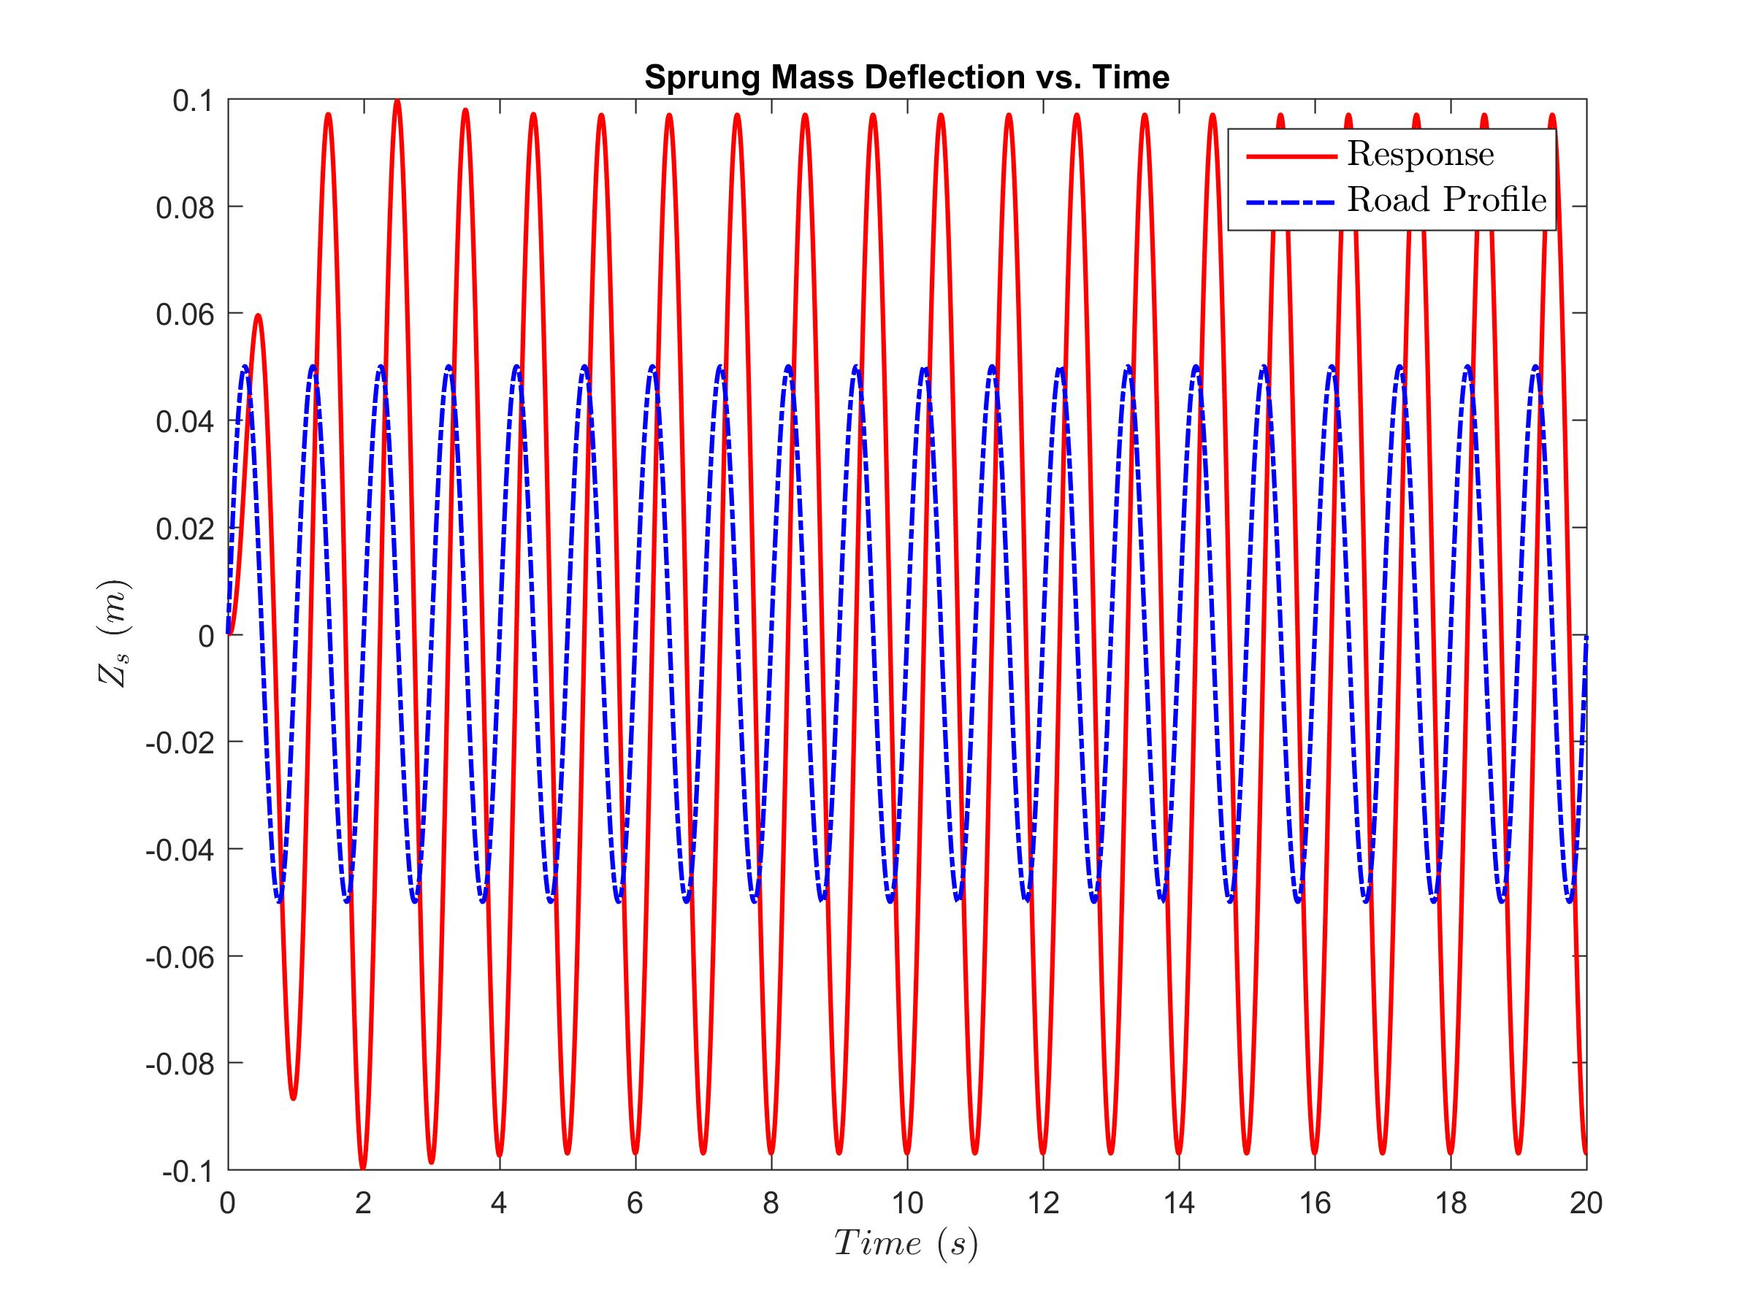
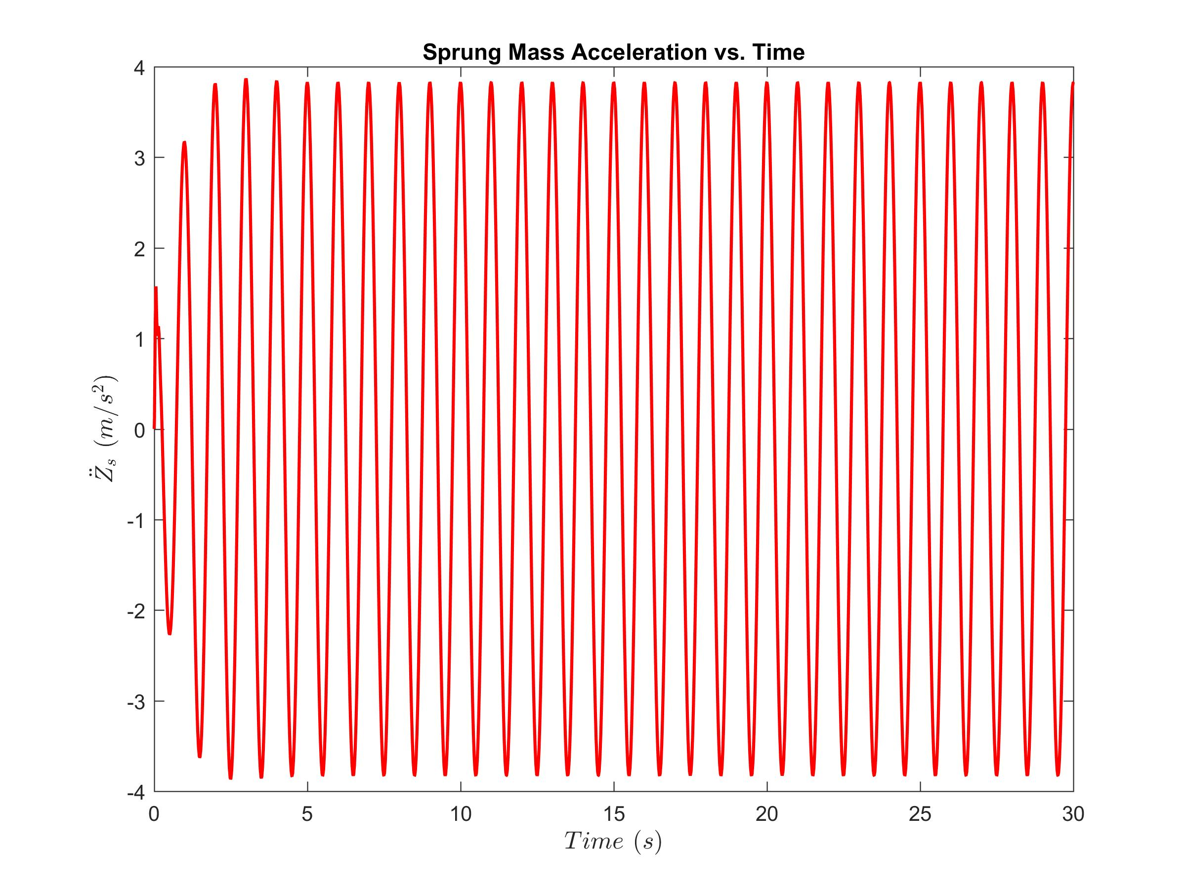
Passive System Analysis
Dynamic Input: Road with continuous bumps!

Slide 13


Optimal Controller
Performance Index
Notes:
Three parameters zs_ddot x1 and x3 are important, others to make Q PD

Slide 14



Optimal Controller
Performance Index

Slide 15
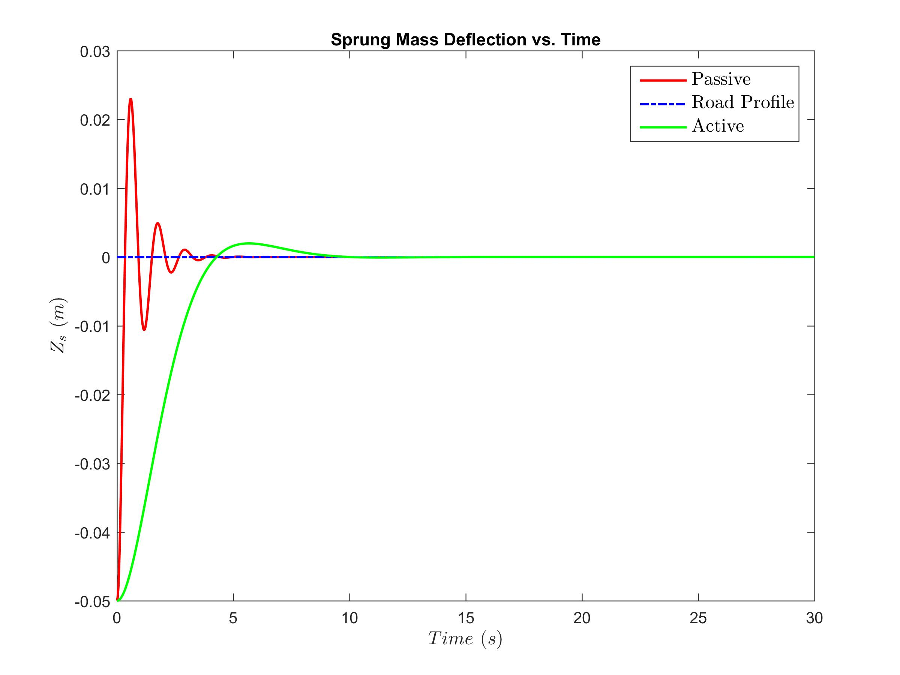
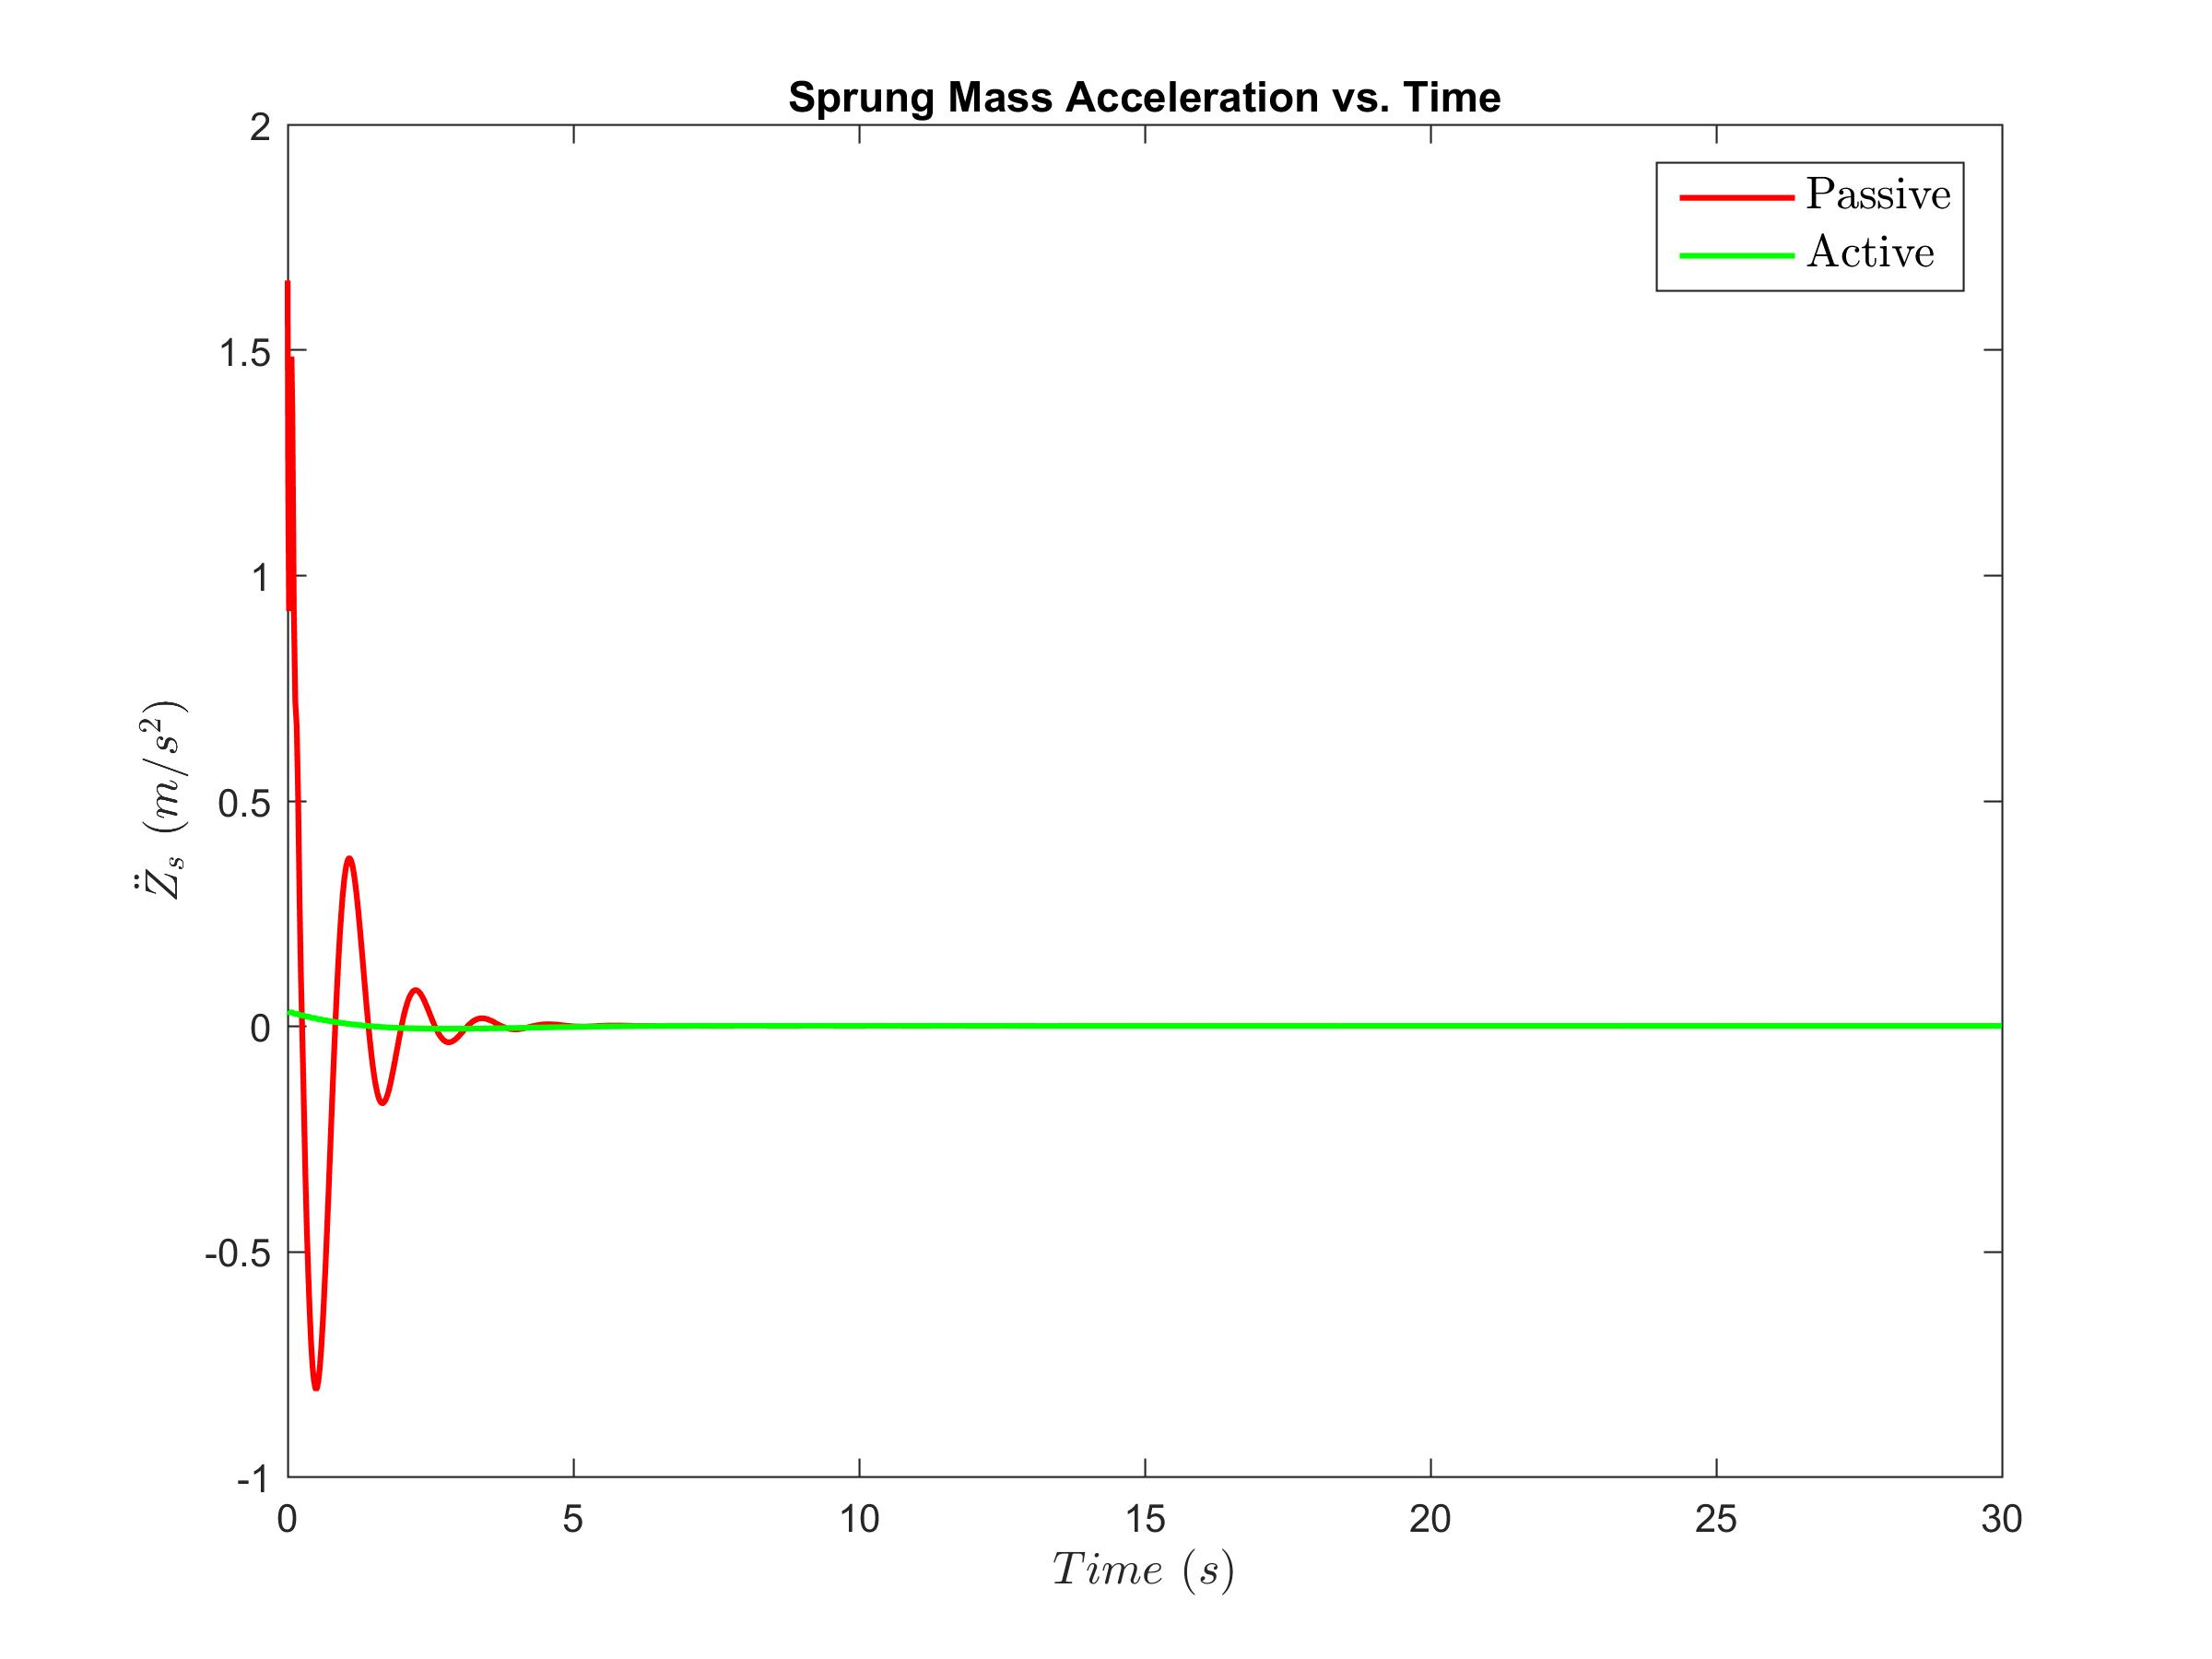
Open Loop Controller
Final time fixed, Final state free: Static Input
Notes:
Slower response because cost function puts weight on acceleration

Slide 16
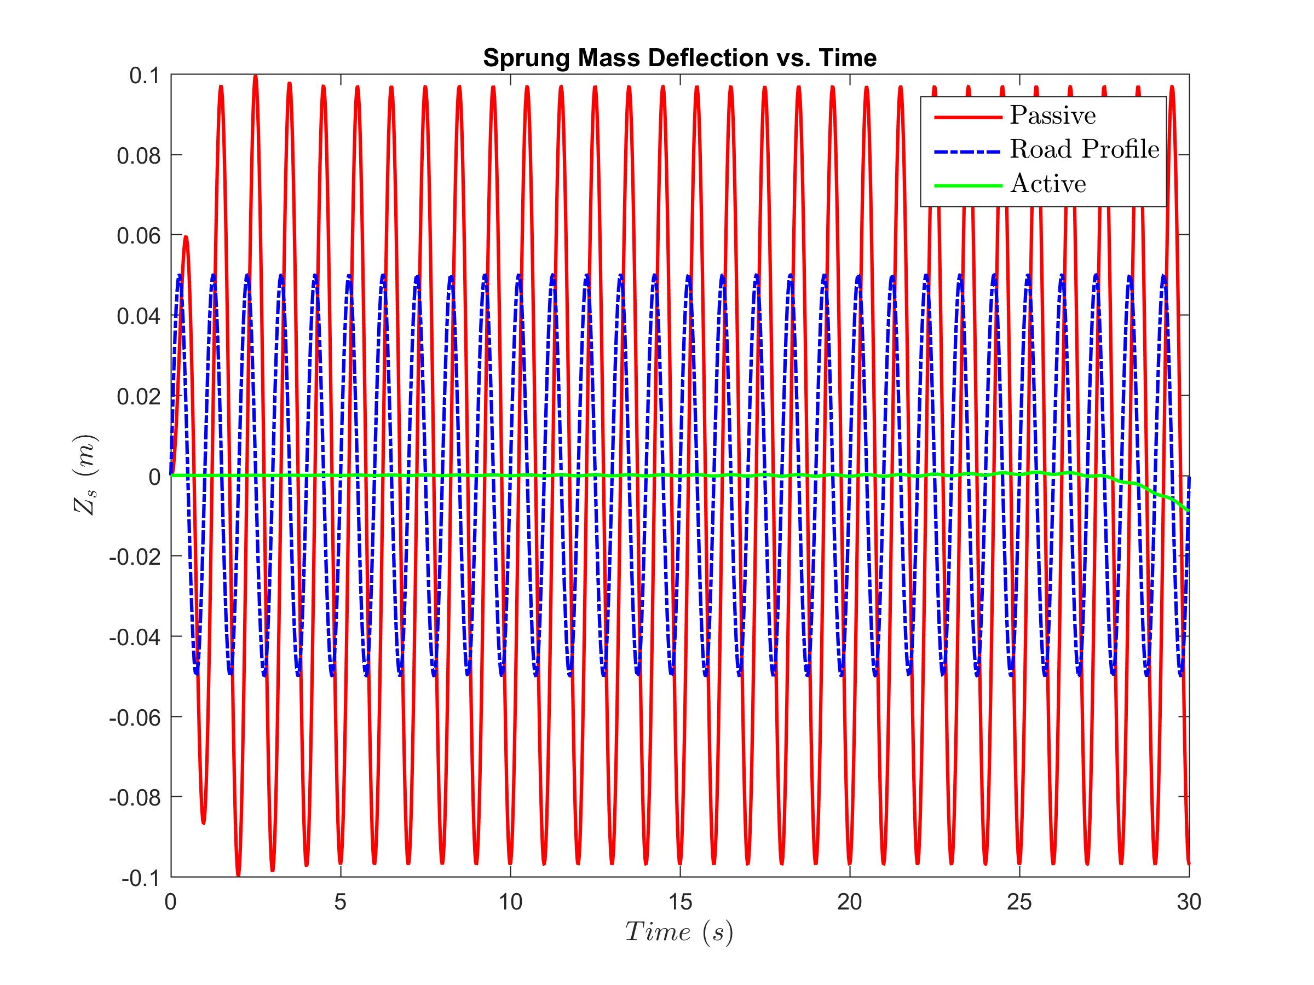
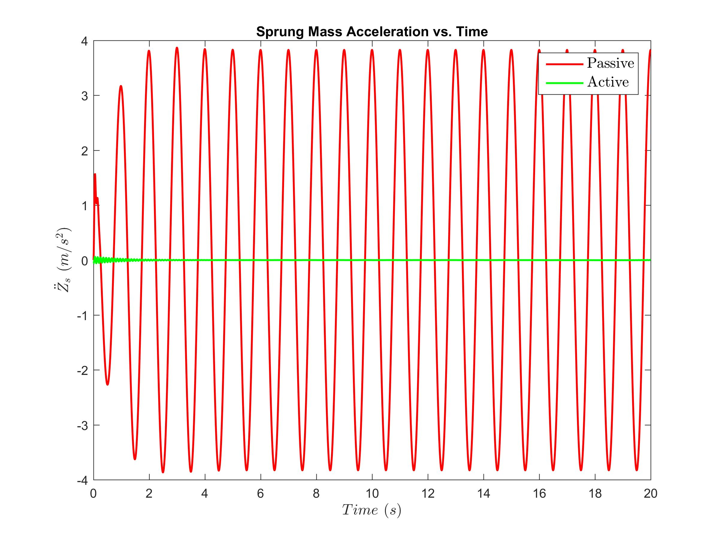
Open Loop Controller
Final time fixed, Final state free; Dynamic Input

Slide 17
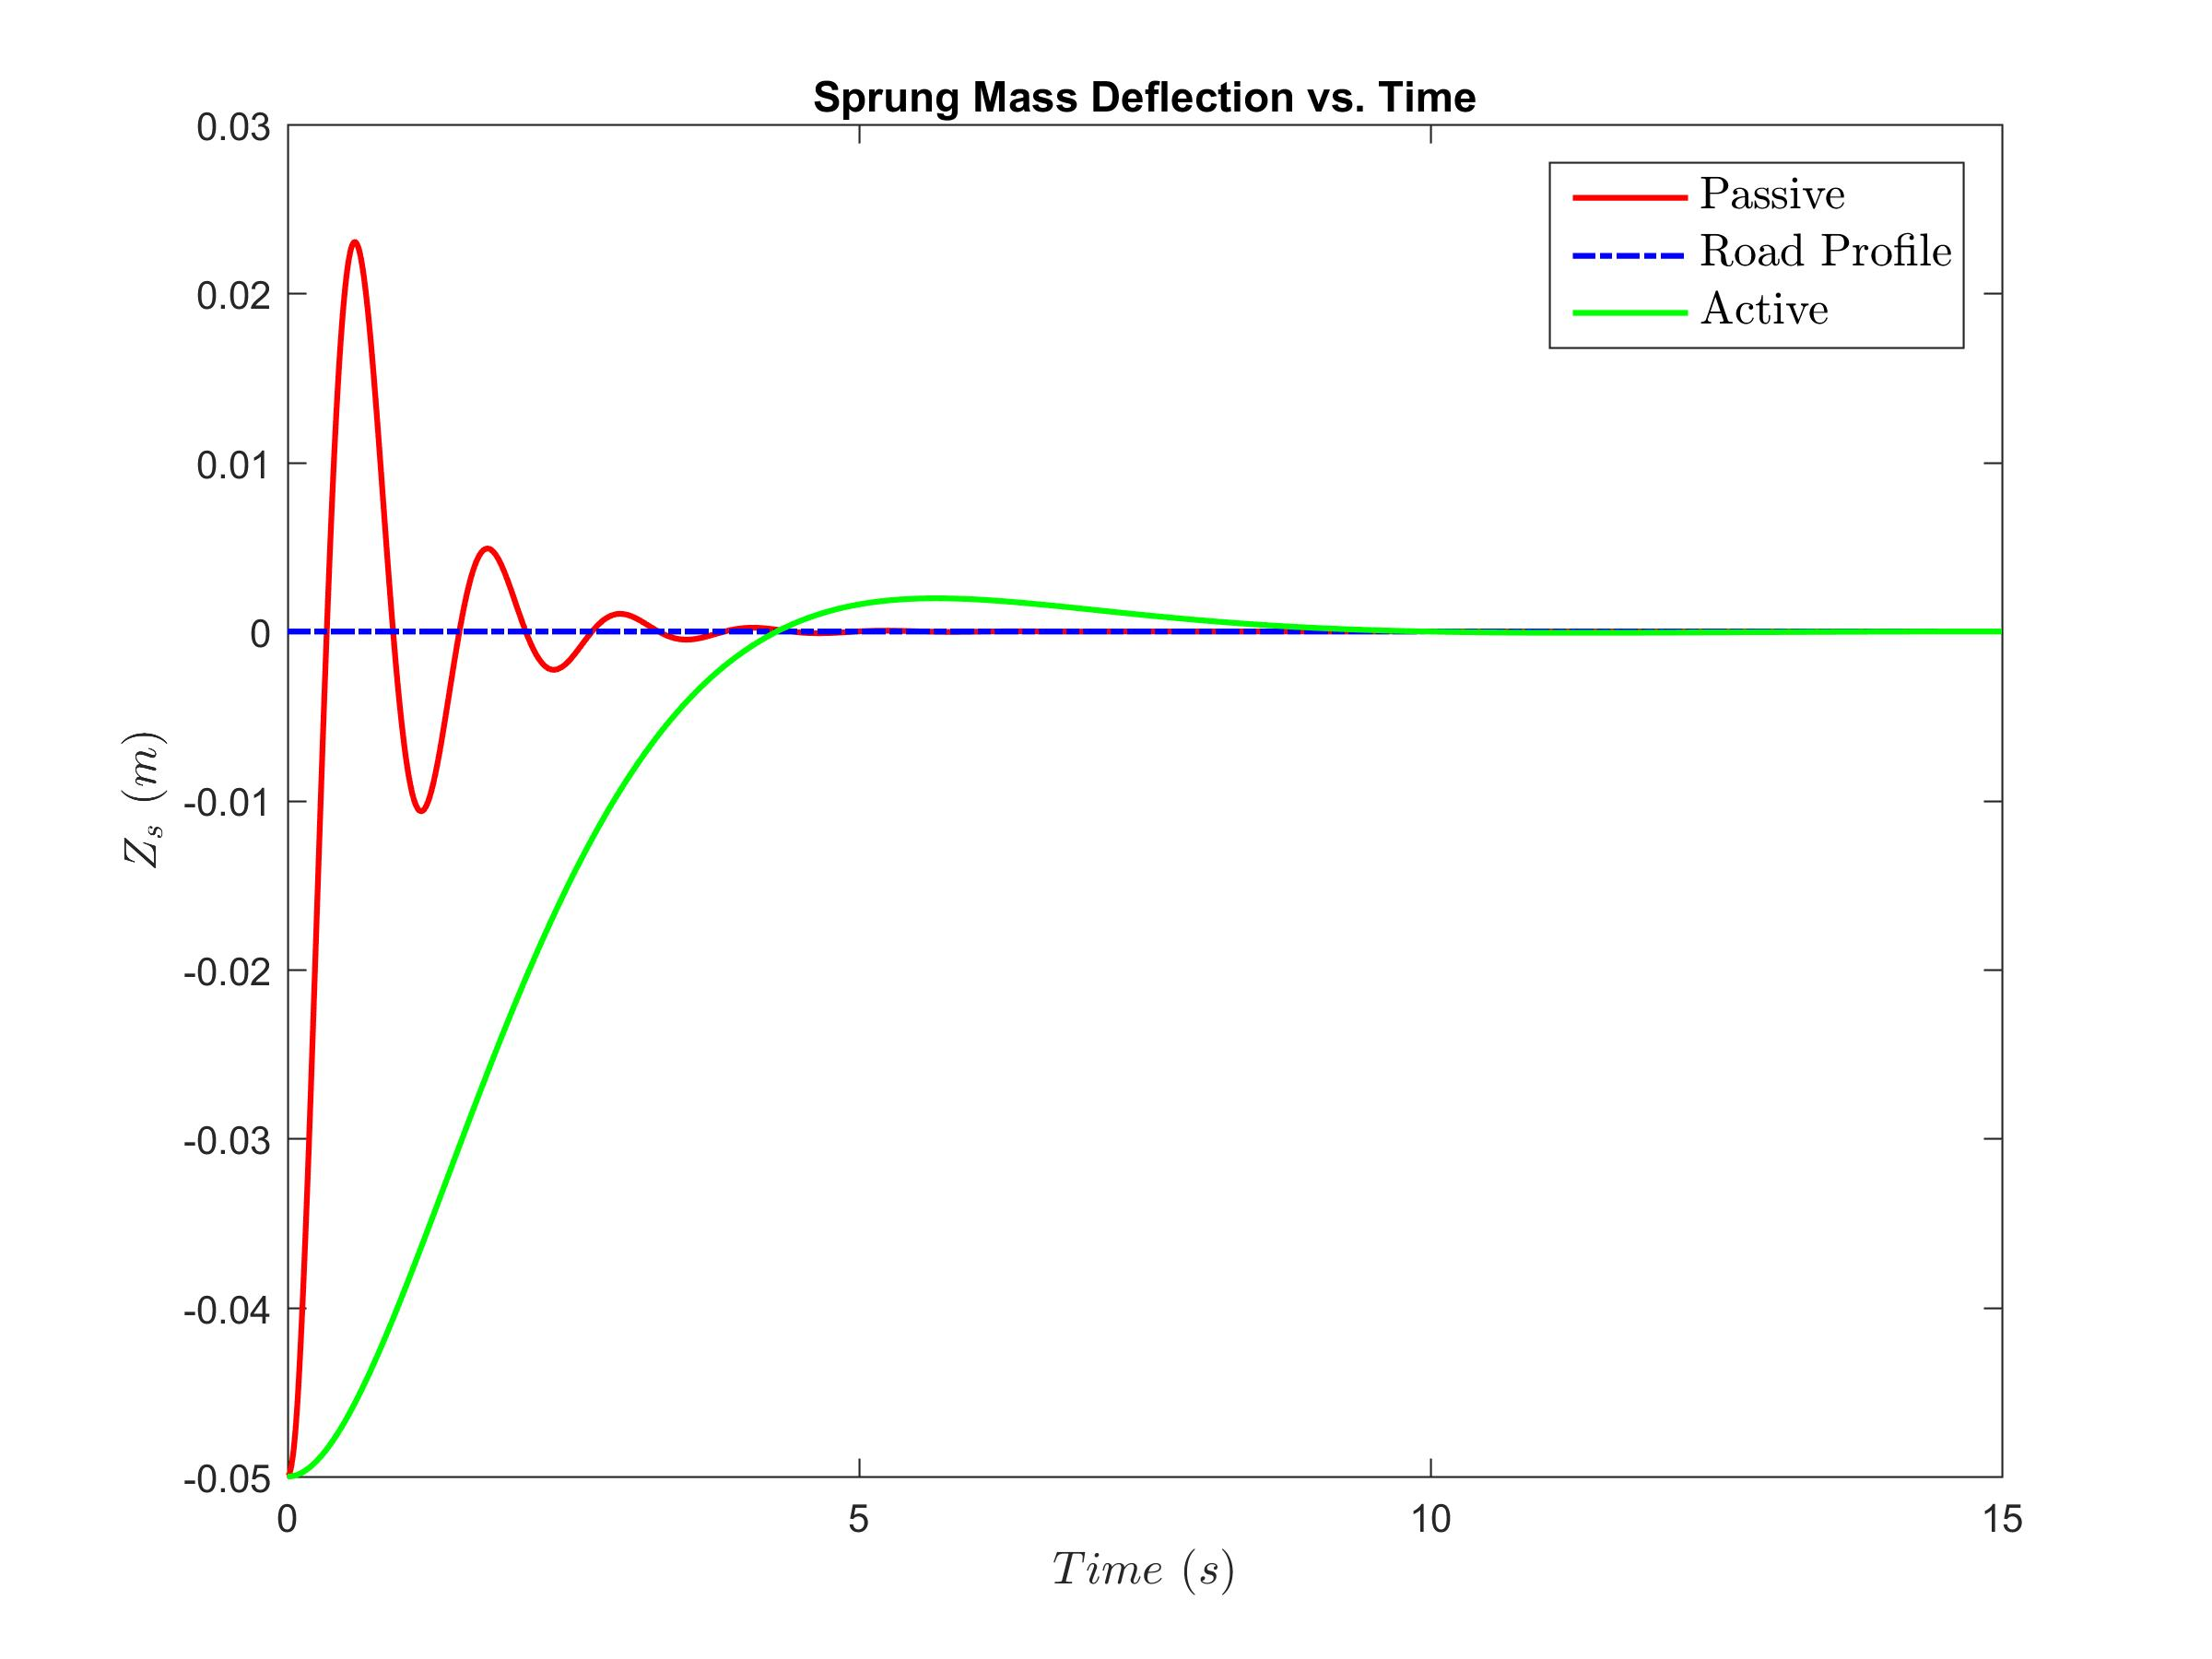
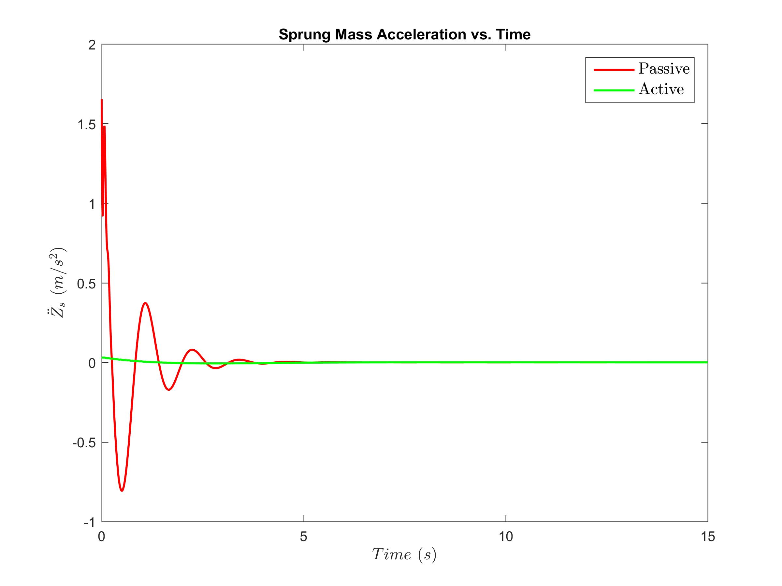
Open Loop Controller
Final state fixed, final time fixed (all states driven to zero)

Slide 18
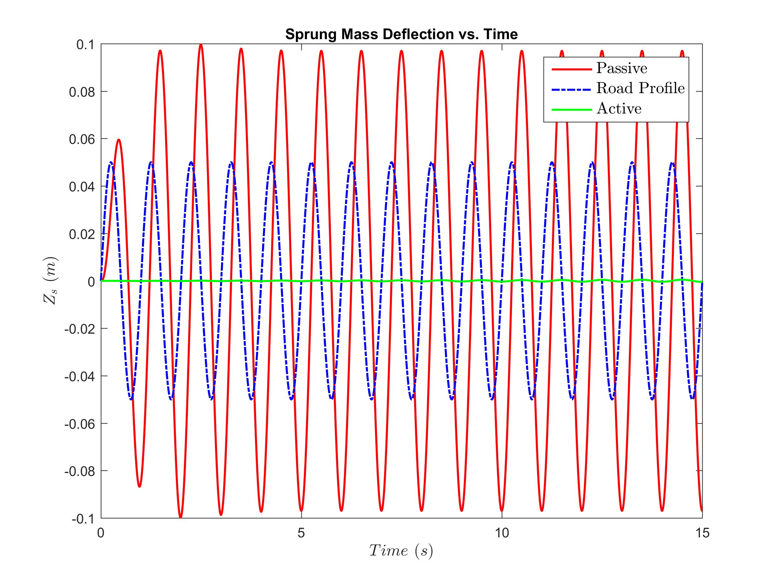
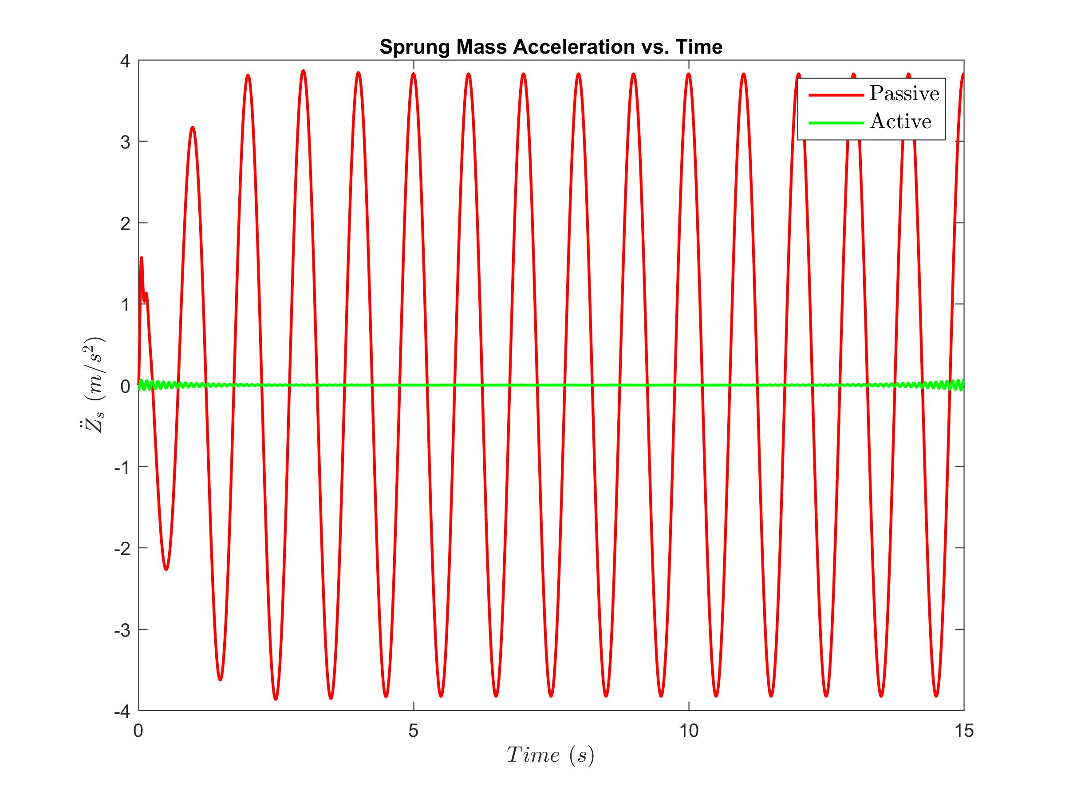
Open Loop Controller
Final state fixed, final time fixed
Notes:
Oscillations at the end for the Z_ddot as it is not a state.

Slide 19
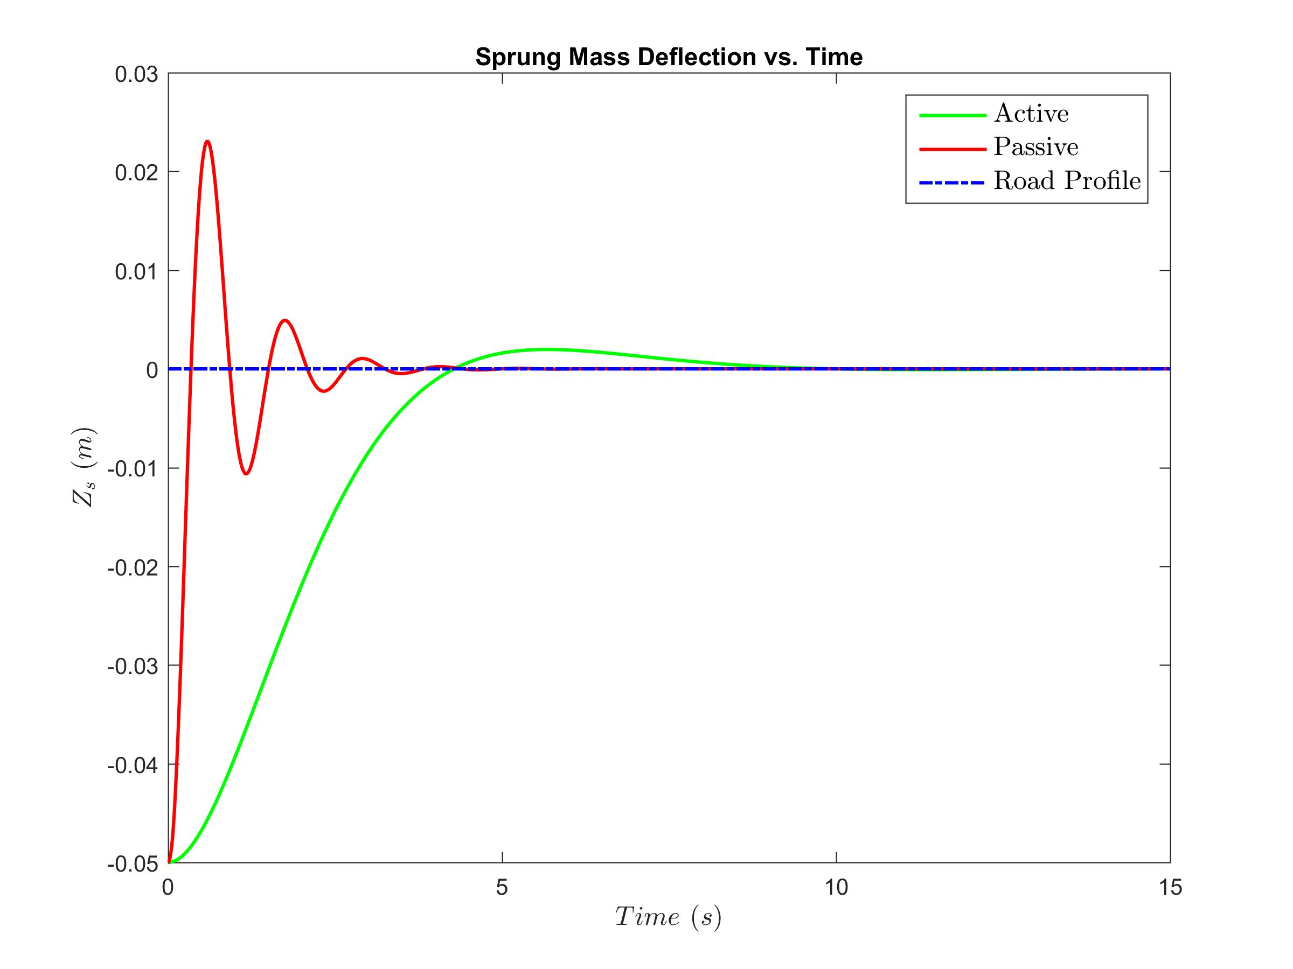
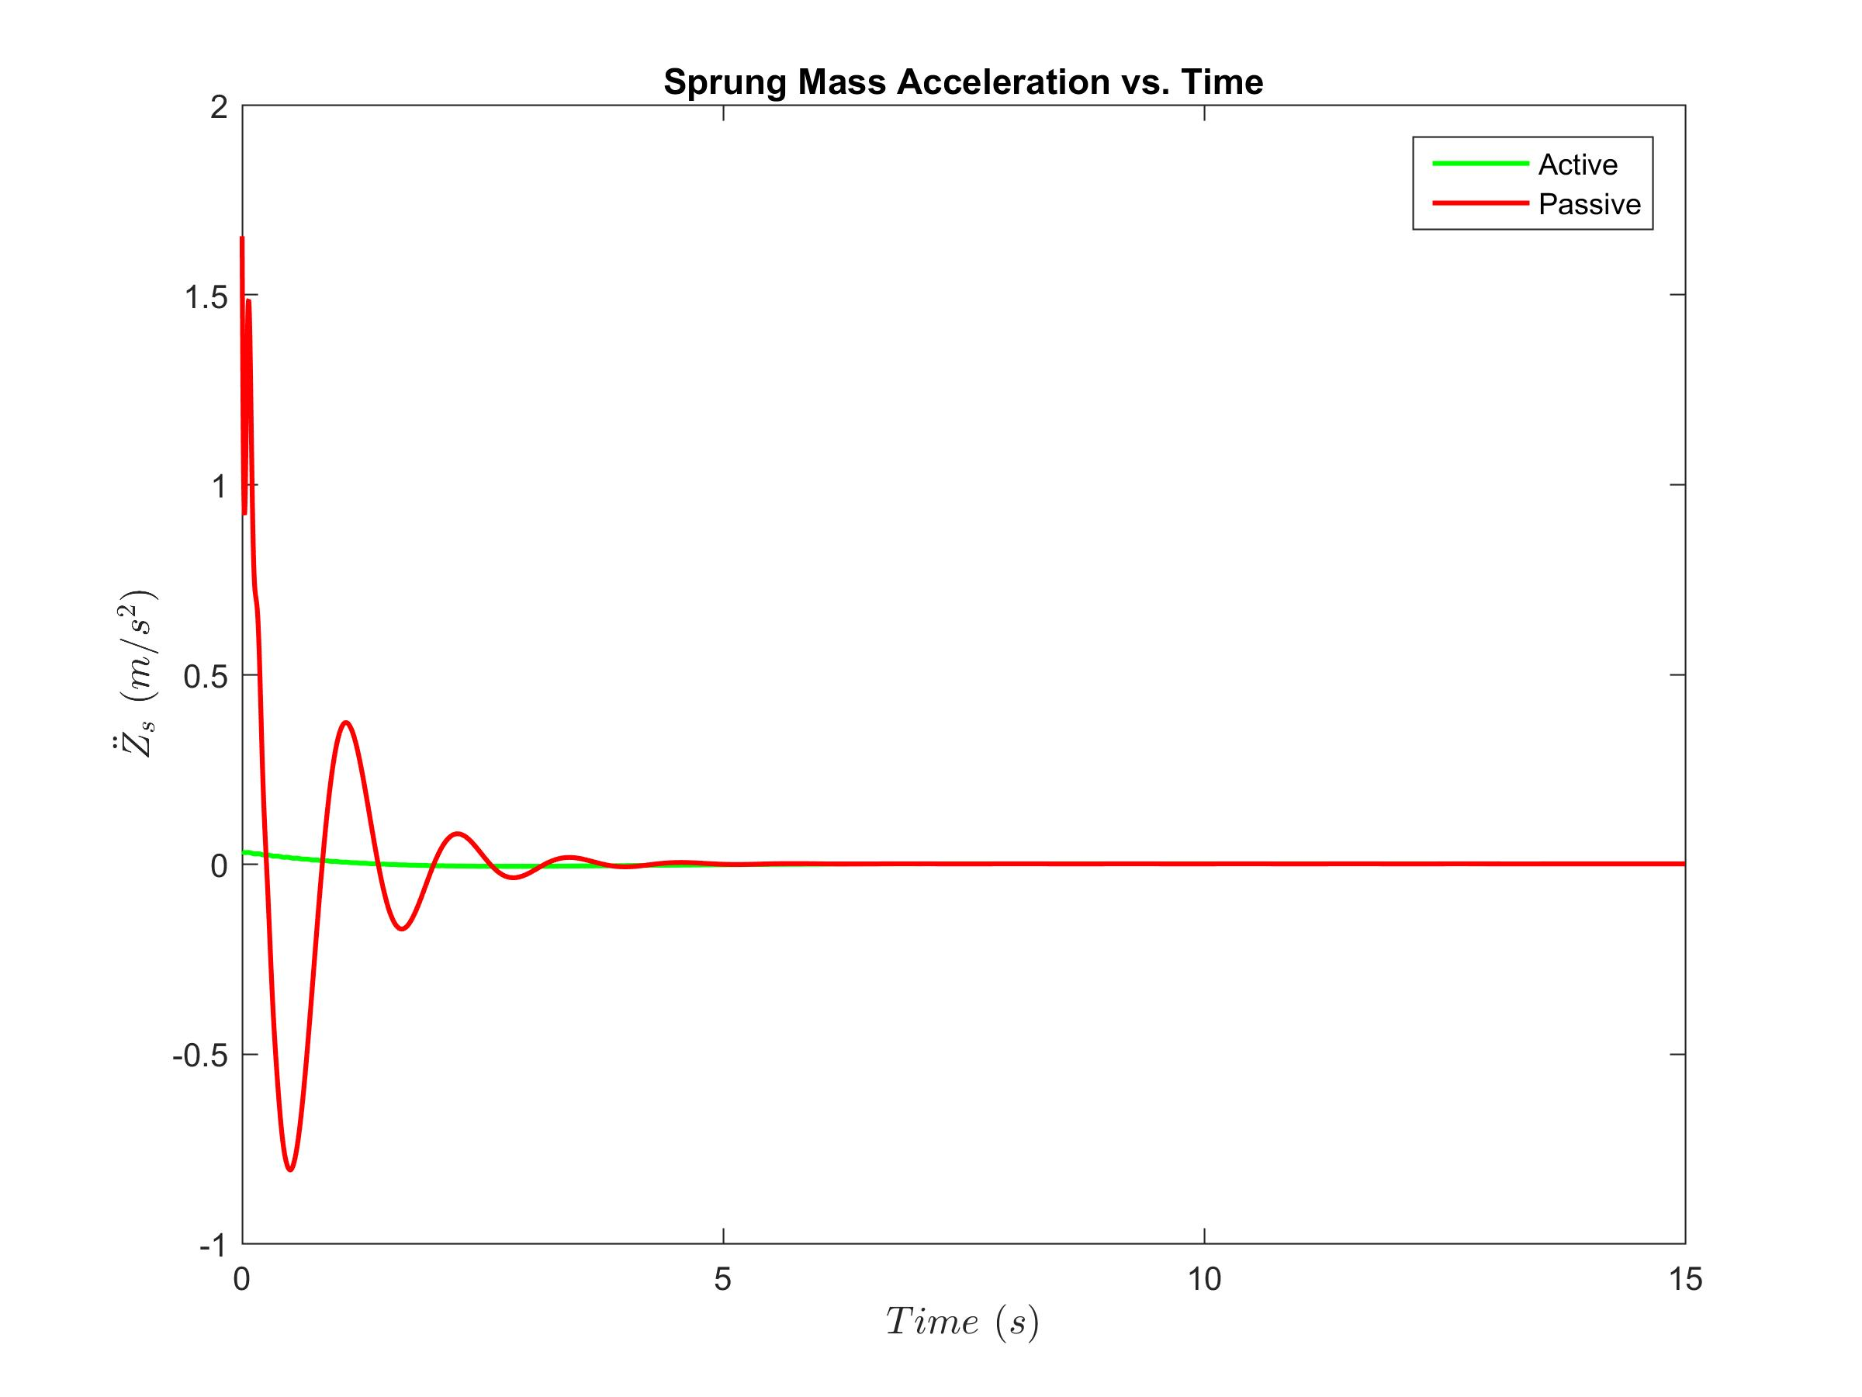
Closed Loop Controller
LQR - infinite time with static input
Notes:
No difference b/w closed and open loop performance because there is no disturbance to the system.

Slide 20

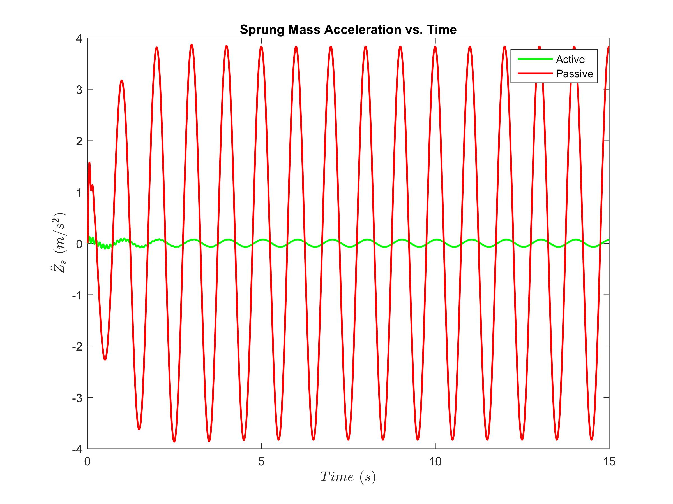
Closed Loop Controller
LQR - infinite time with dynamic input

Slide 21
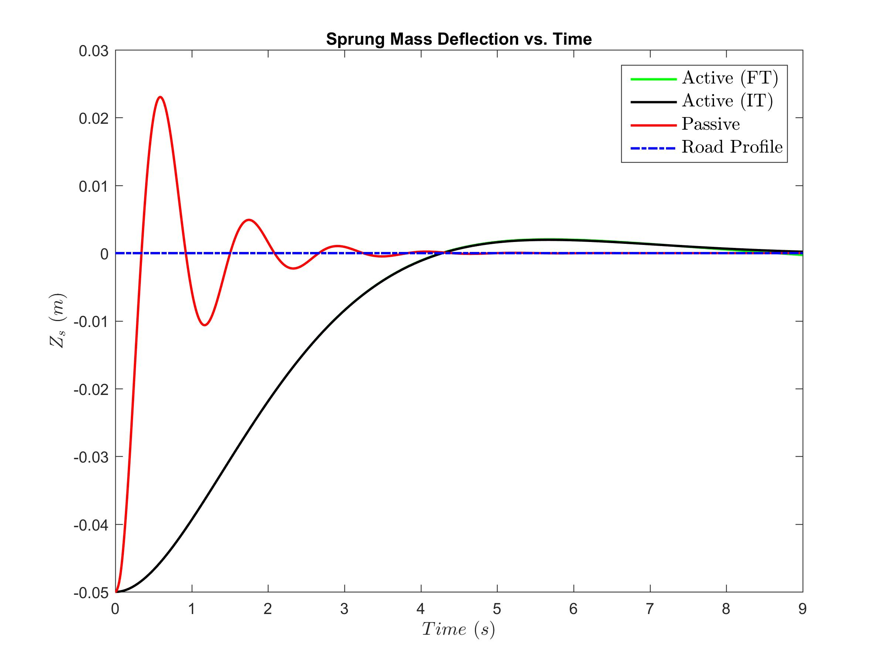
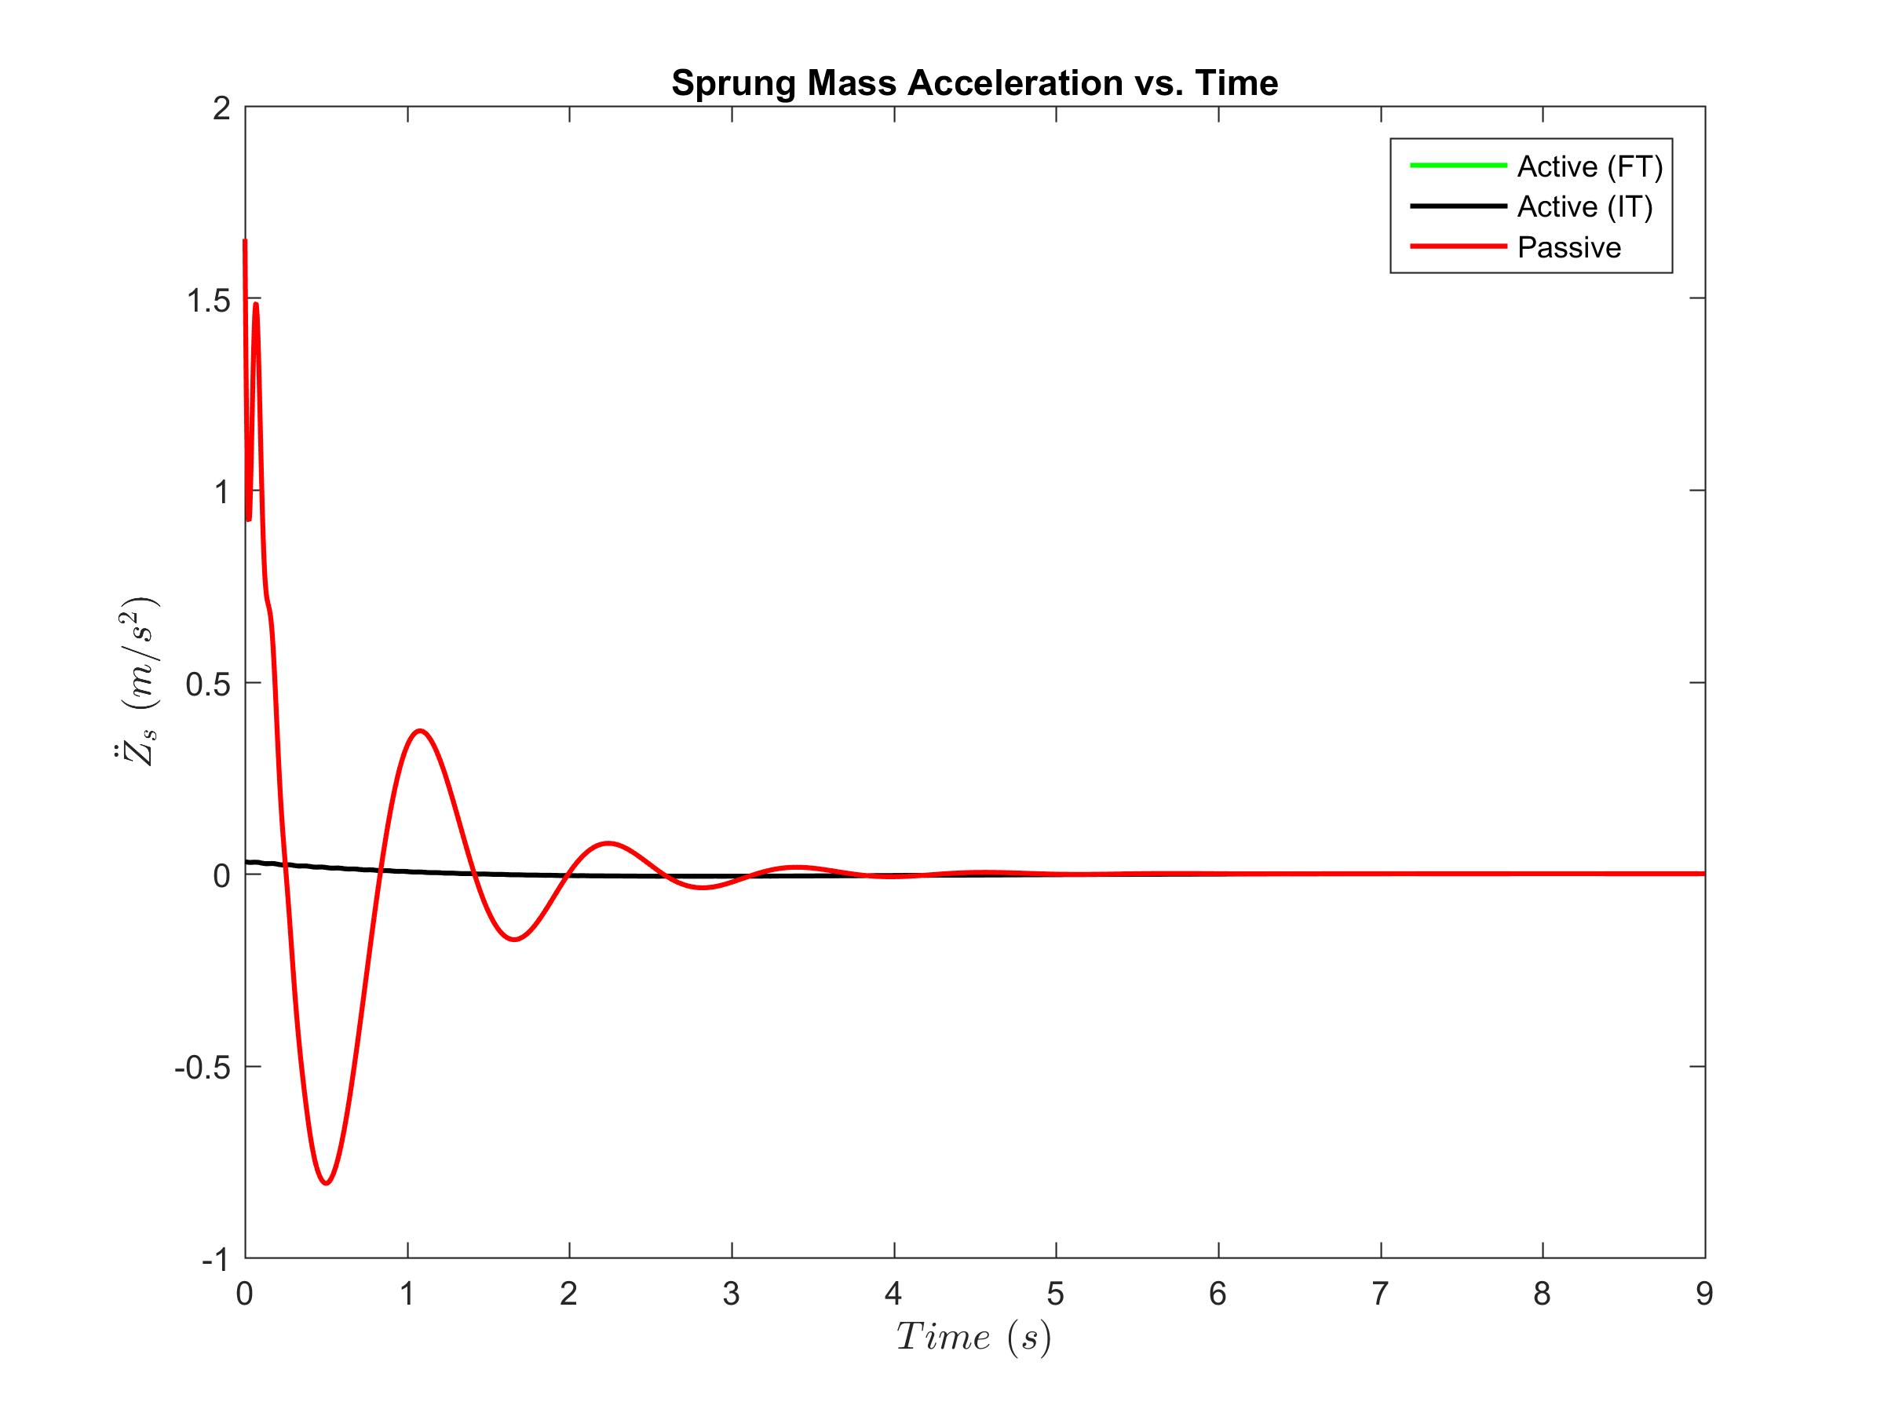
Closed Loop Controller
LQR - finite time with static input
Notes:
Not a visible diff b/w finite and infinite time responses

Slide 22
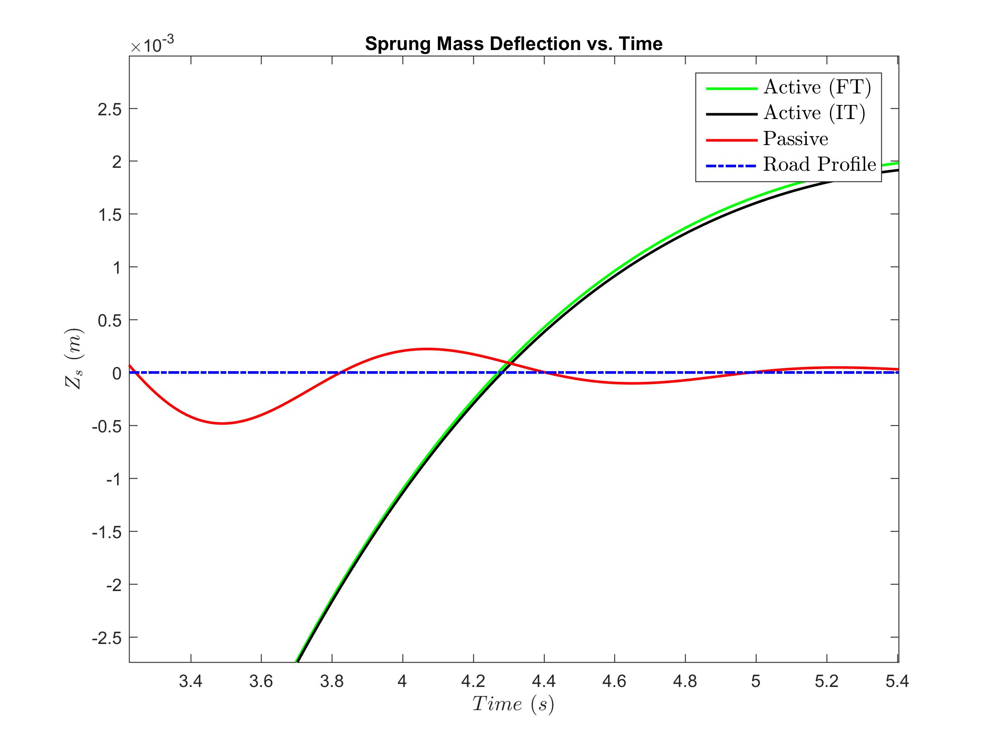
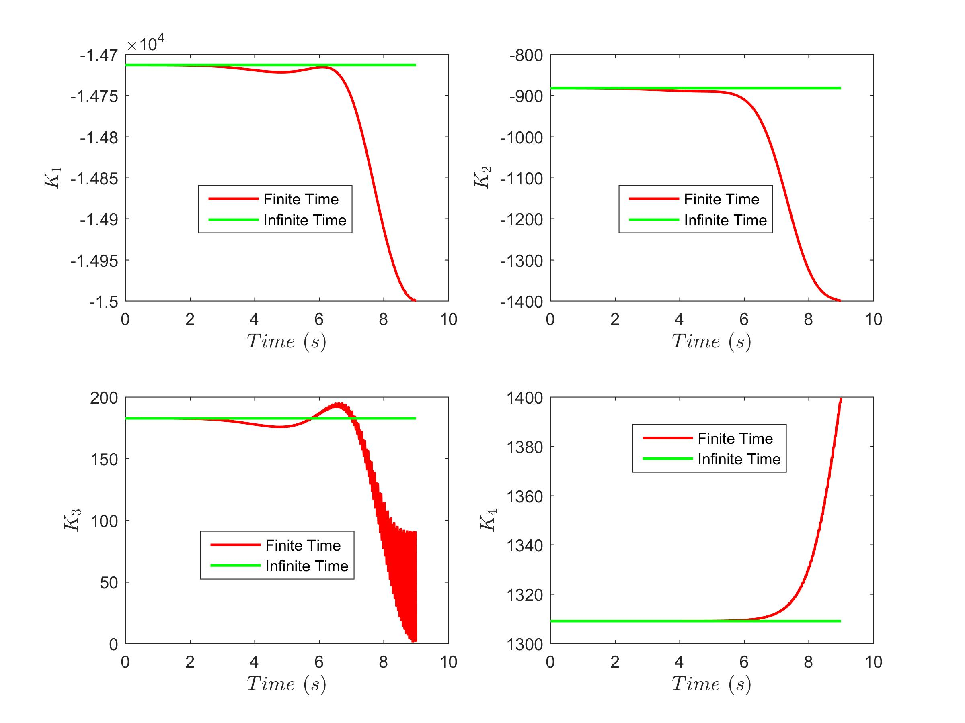
Closed Loop Controller
LQR - finite time with static input
Finite time LQR is faster!
Gain updates

Slide 23
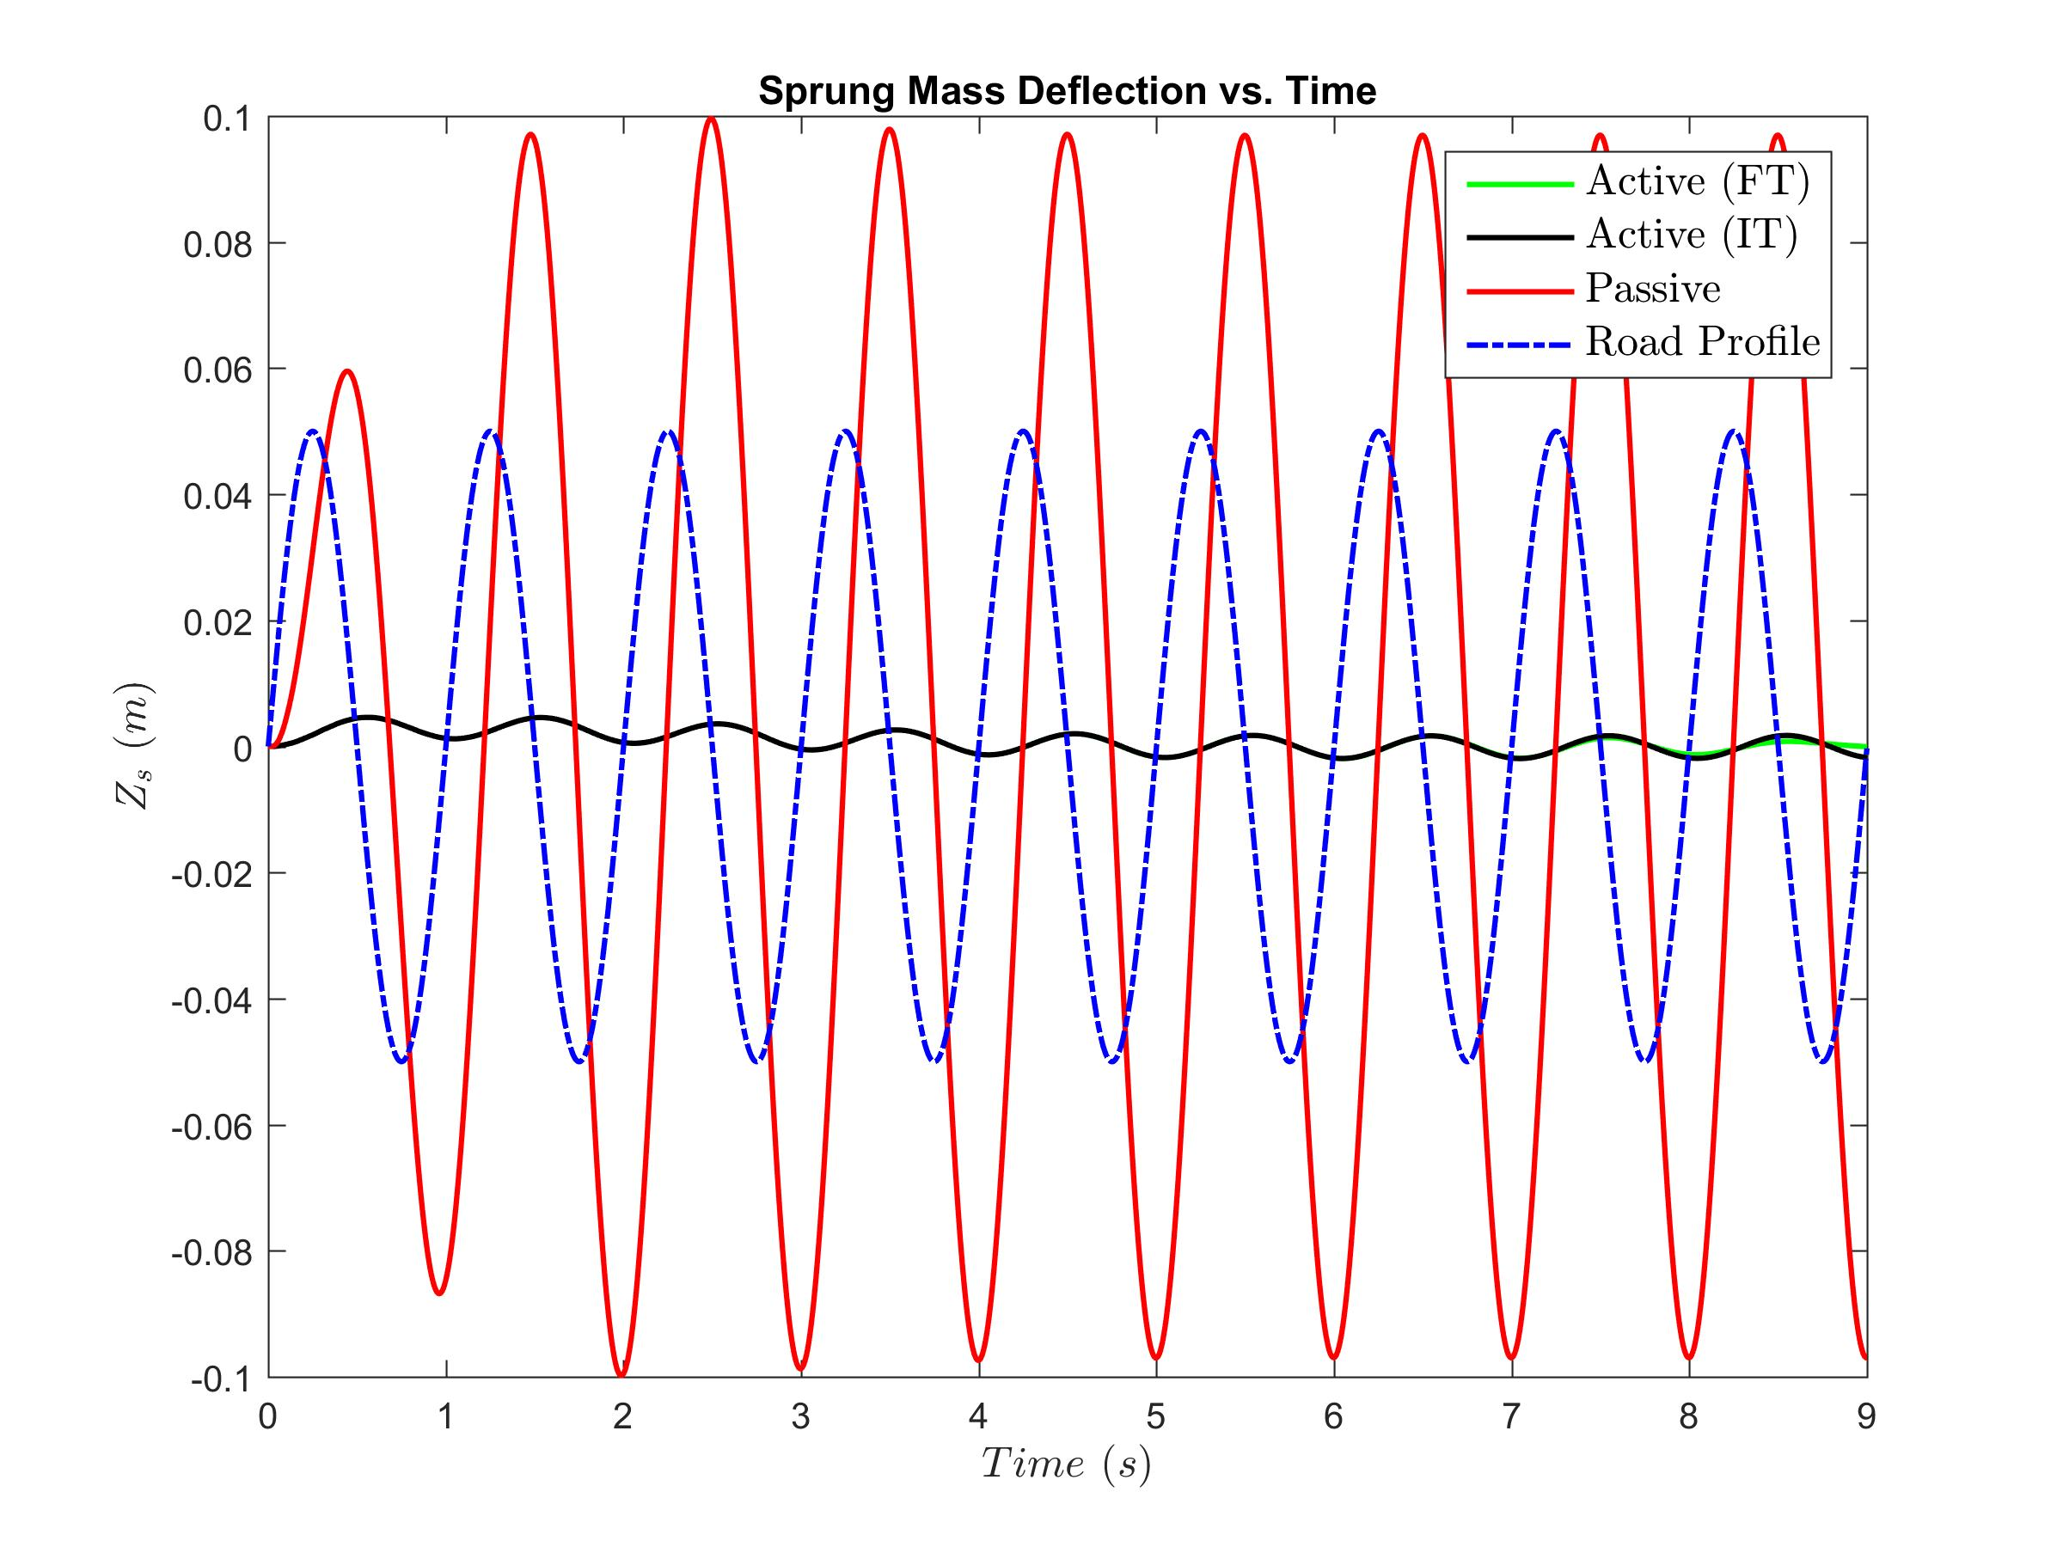
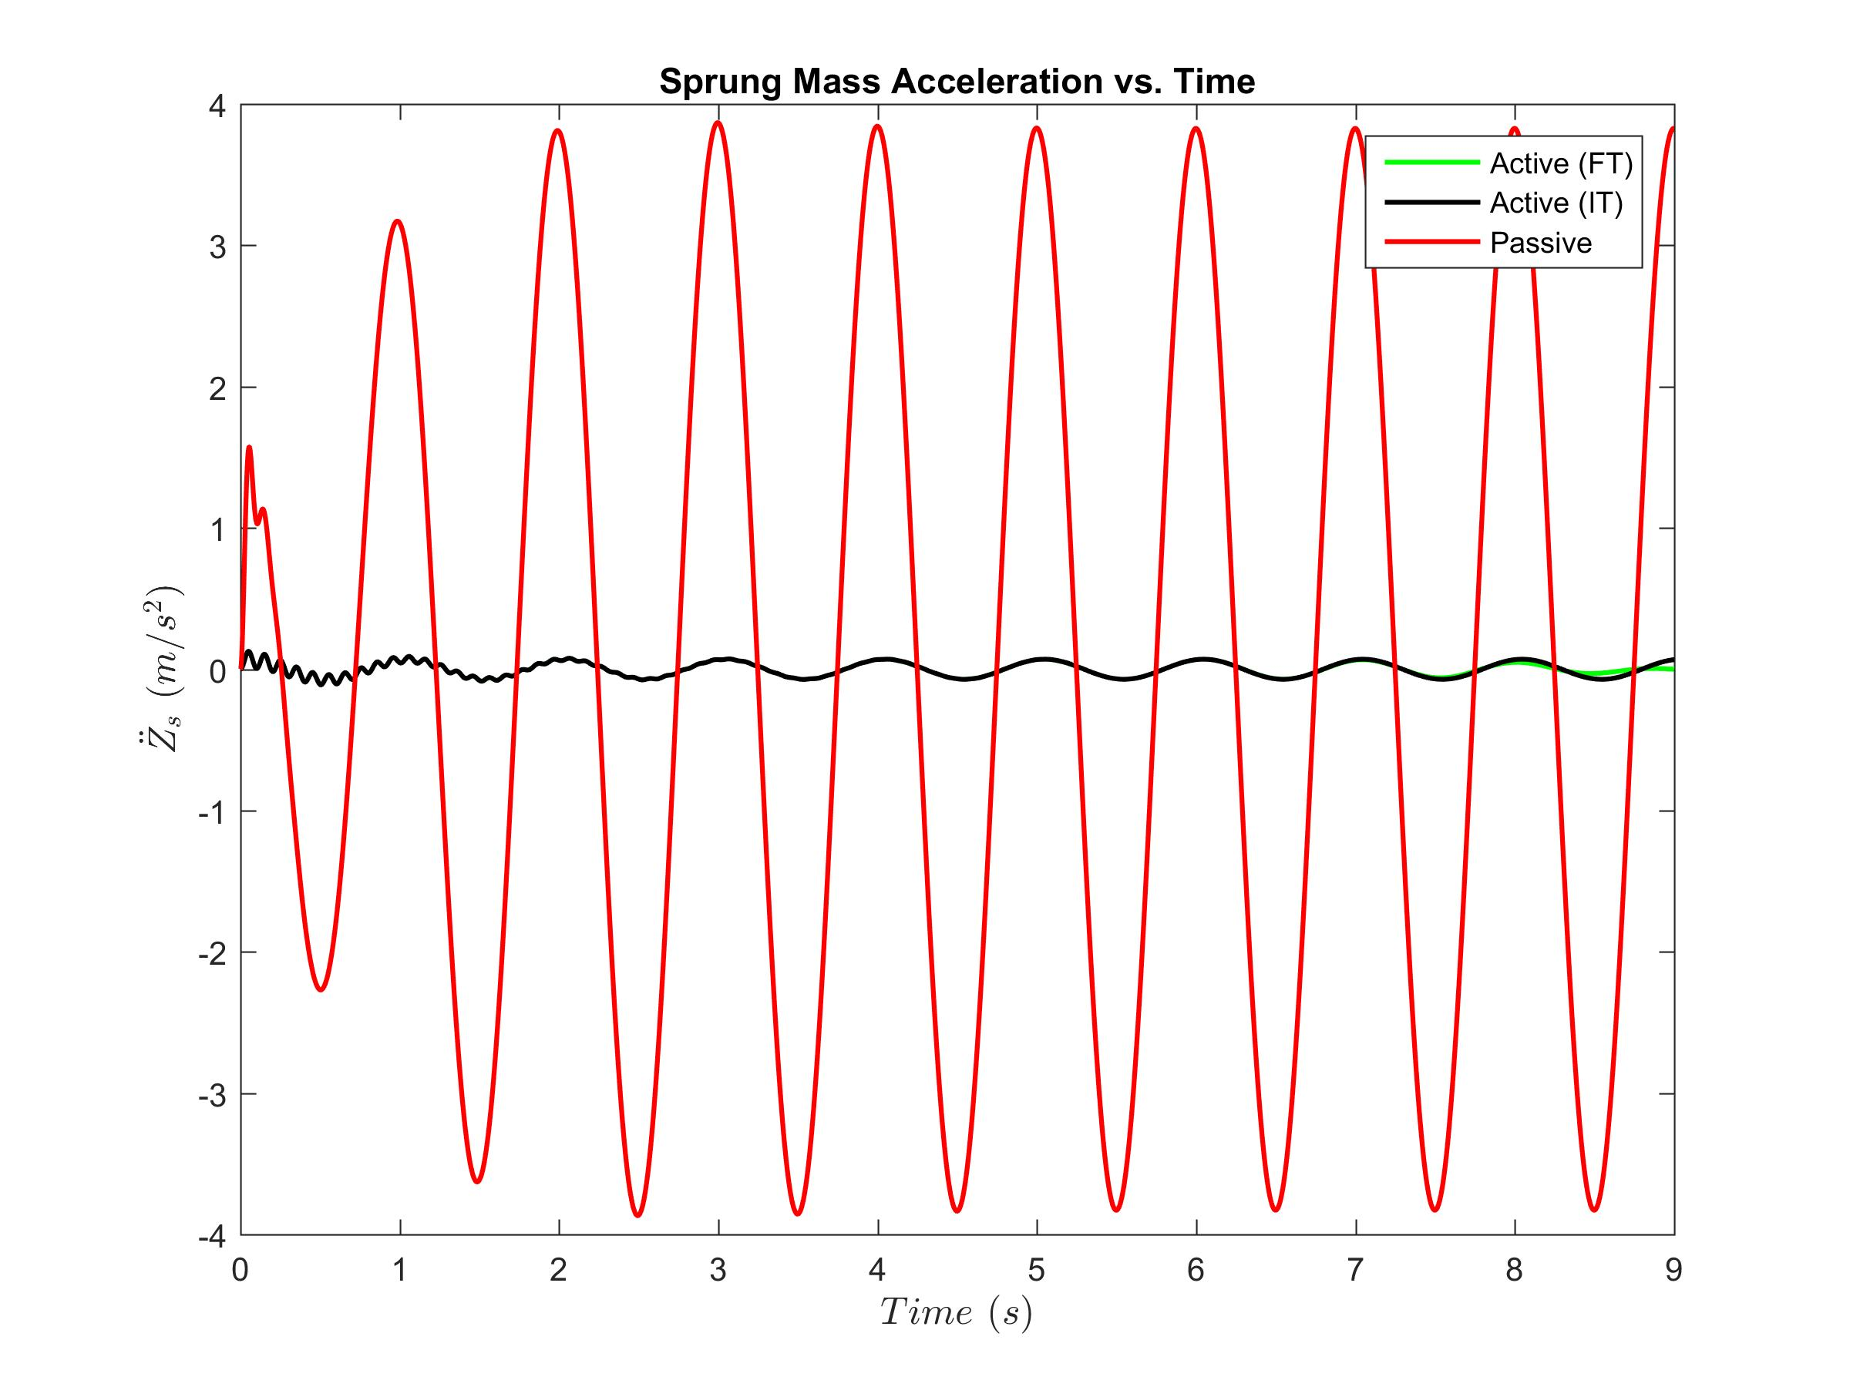
Closed Loop Controller
LQR - finite time with Dynamic Input

Slide 24
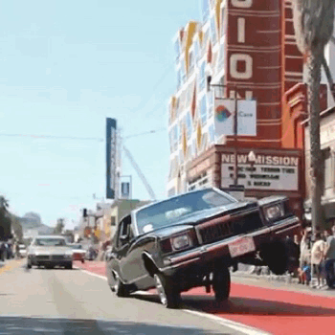

Slide 25
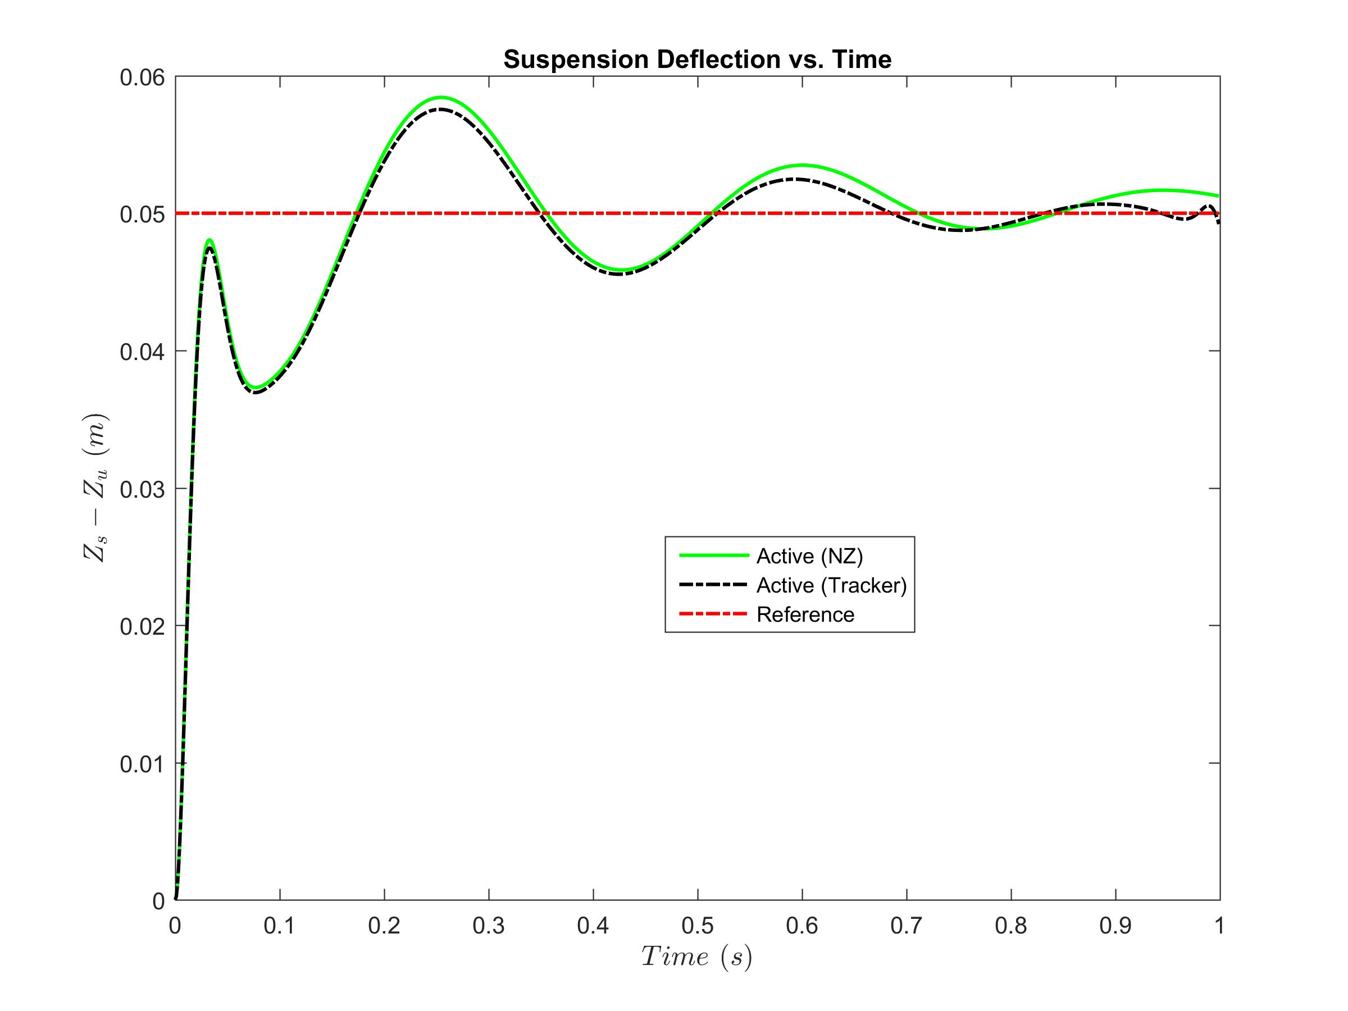
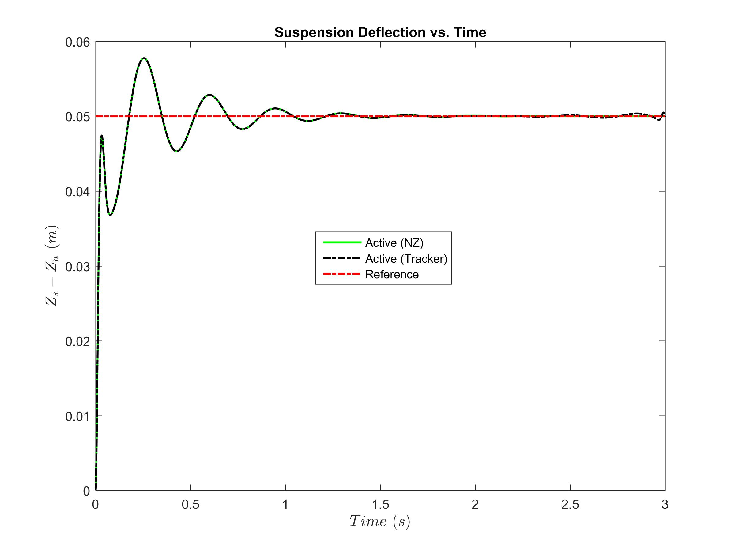


Closed Loop Controller
Non-zero set point (static road input, ρ₁= 100000)
Notes:
Finite and infinite NZ SP comparison, jumping muscle cars

Slide 26
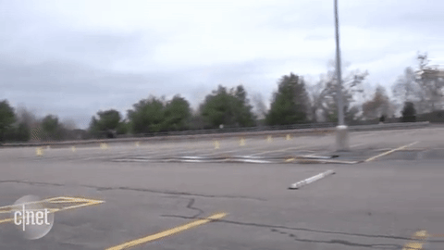

Slide 27
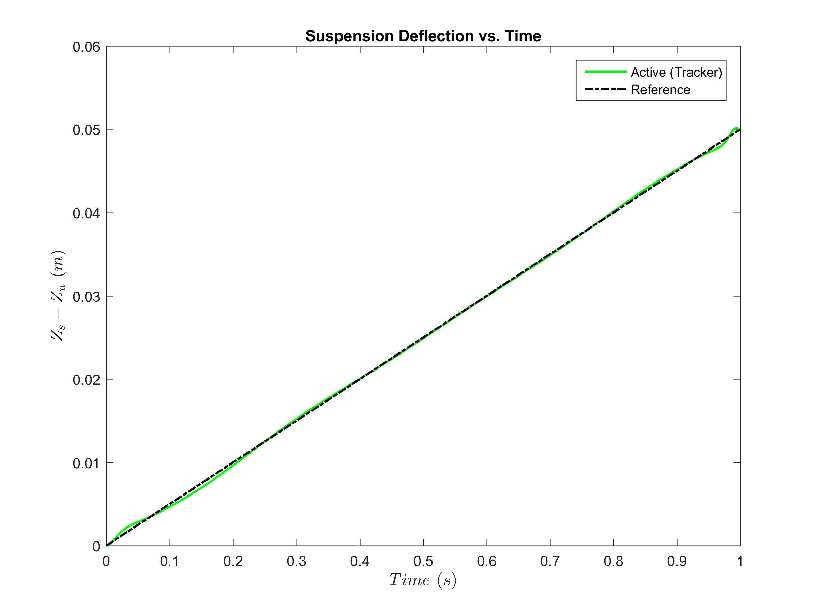
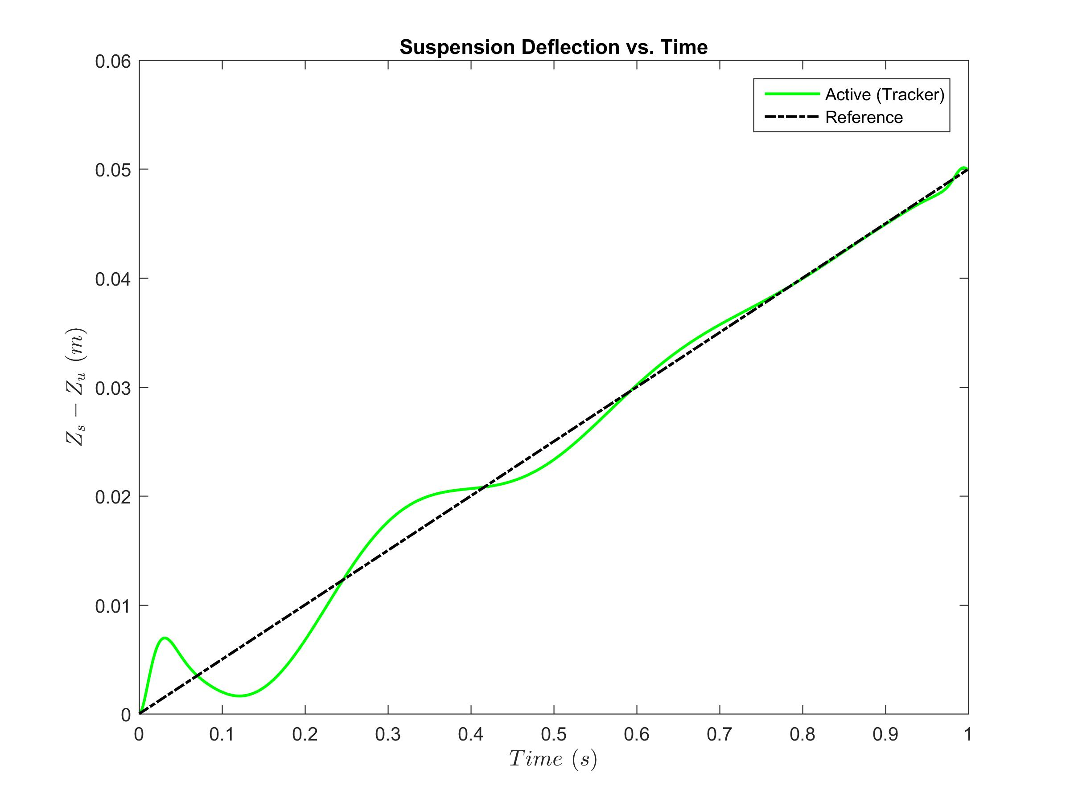
Closed Loop Controller
Finite time Tracker
Static
Dynamic

Slide 28
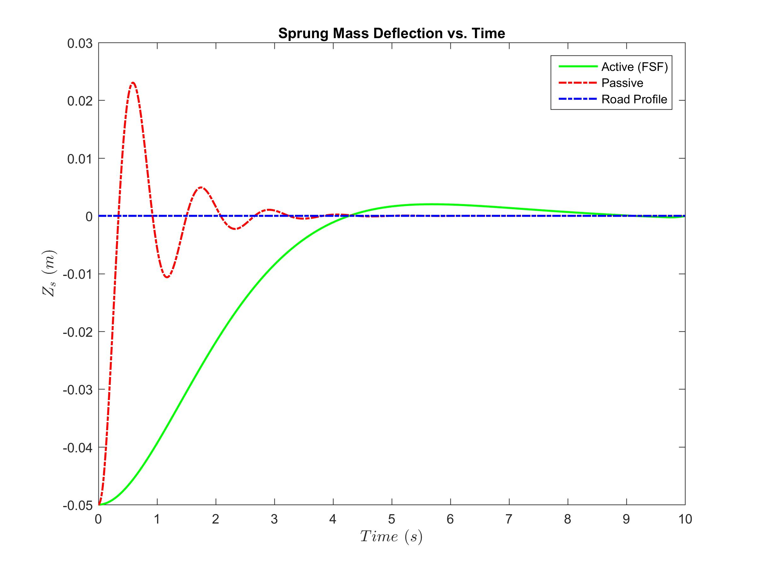
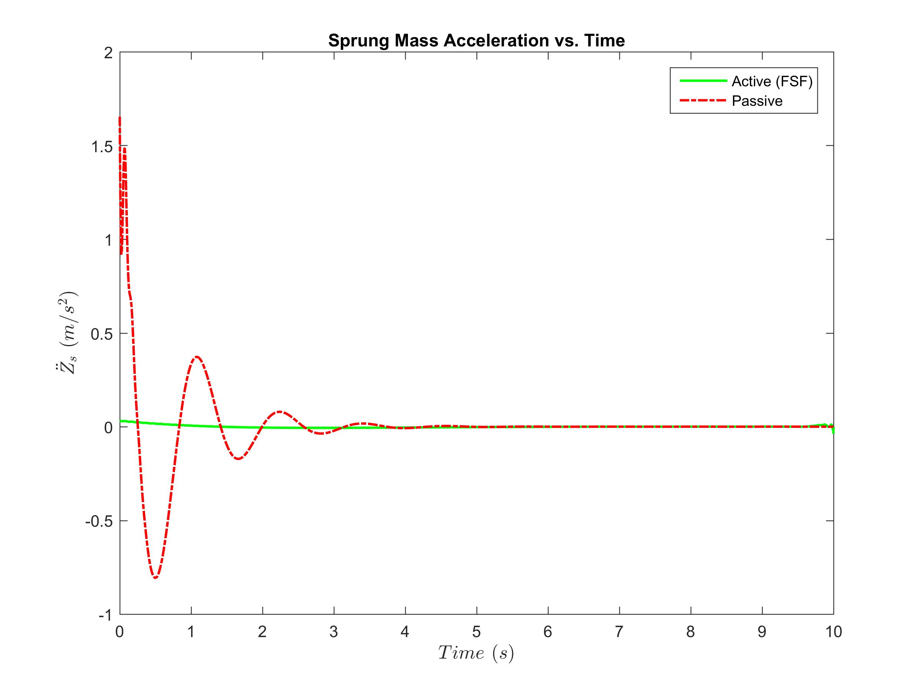
Closed Loop Controller
Final state fixed

Slide 29
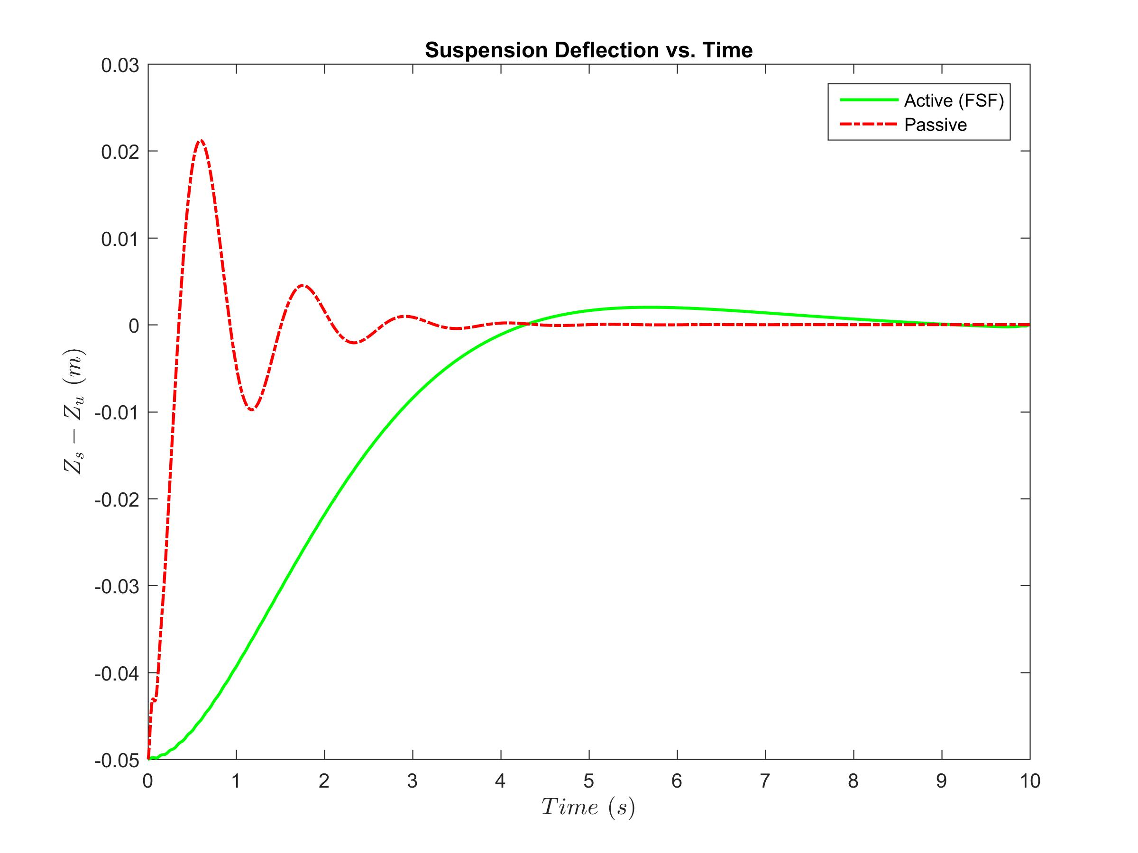
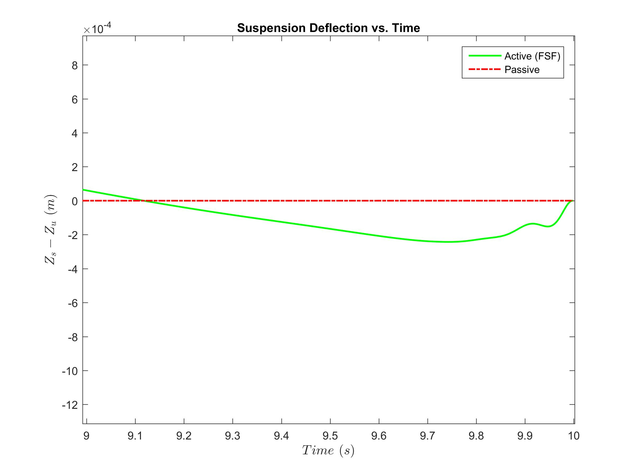
Closed Loop Controller
Final state fixed
Suspension deflection driven to zero!
Notes:
Final state fixed means boundary conditions are defined instead of minimizing costs, therefore system is forced

Slide 30




Reduced Order
Observation Matrix:
Measured States = 2
Estimated States = 2
Estimator Eigenvalues = 20*(Closed Loop Eigenvalues)
Suspension Deflection
Sprung Mass Velocity

Slide 31
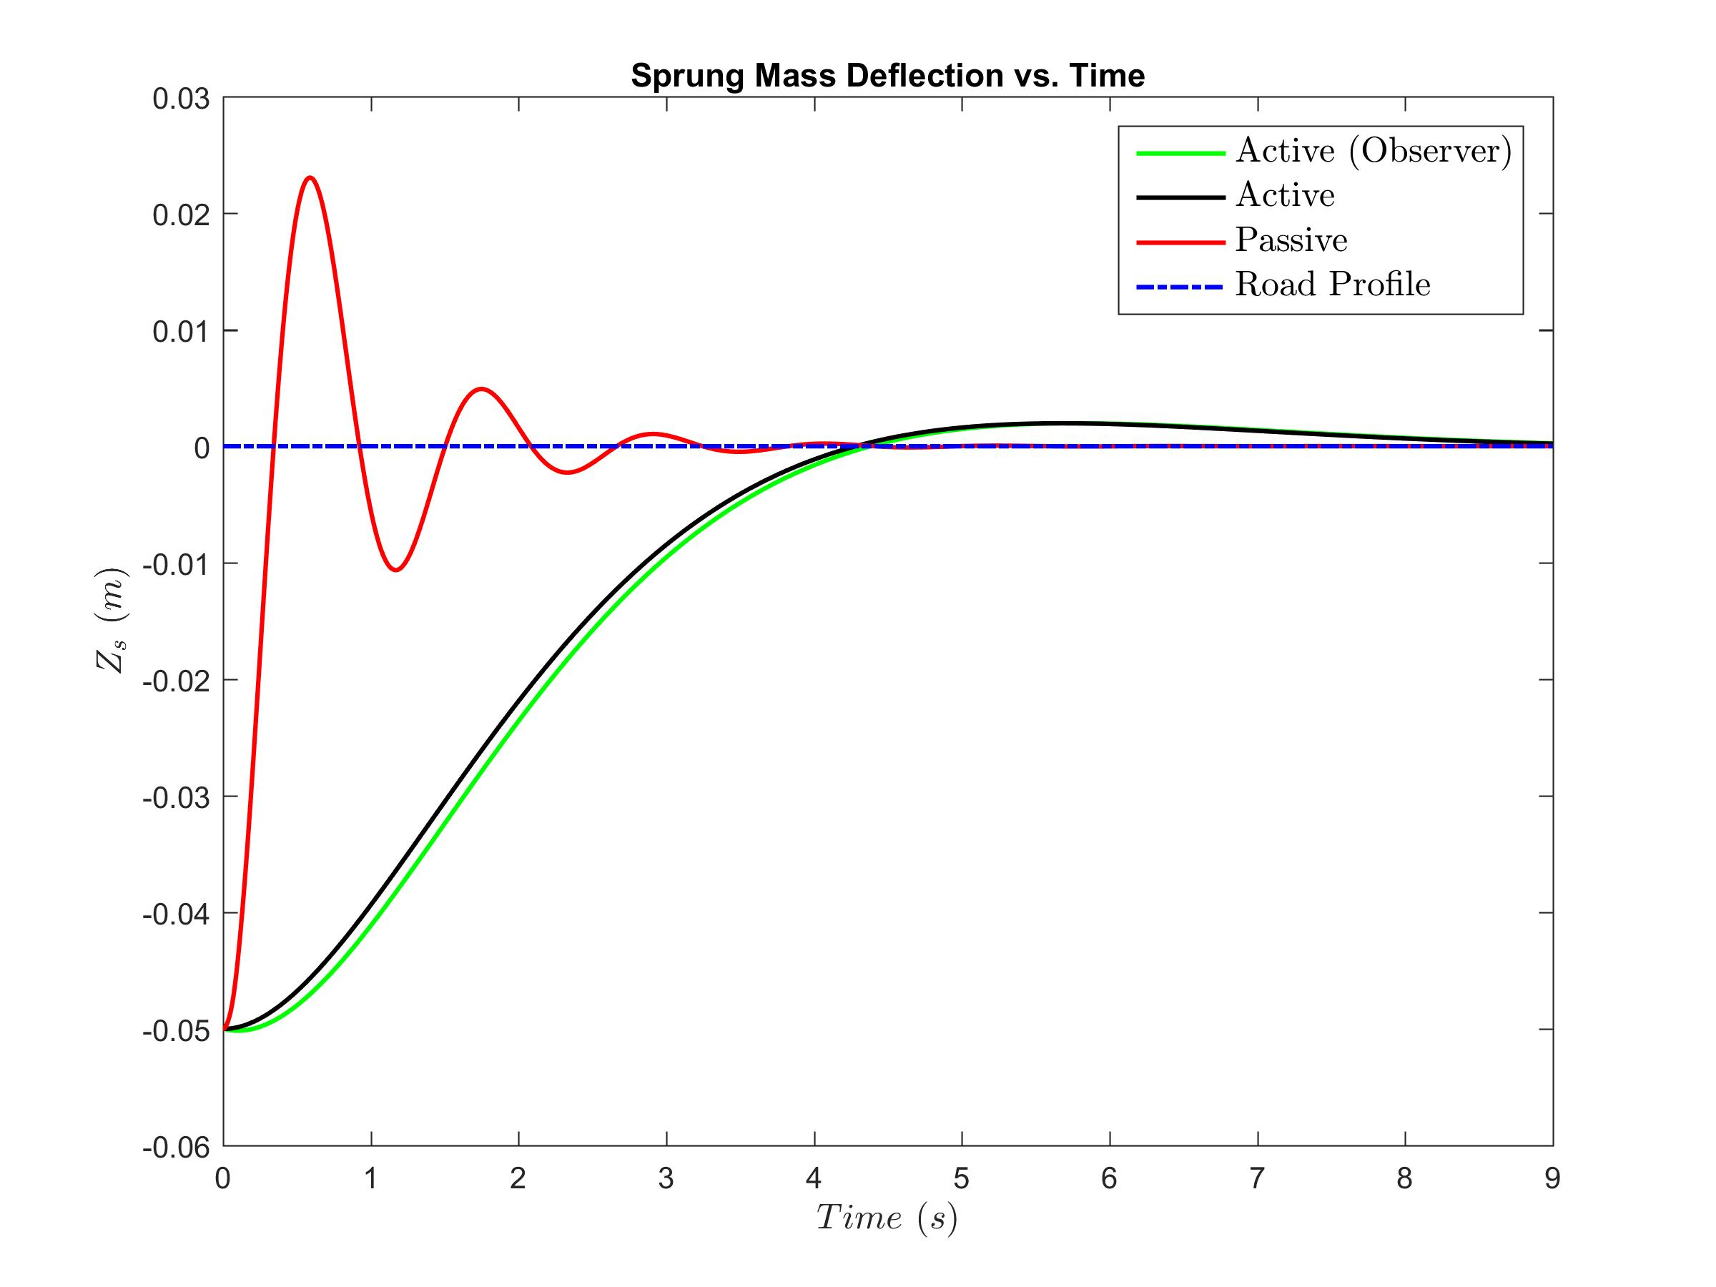
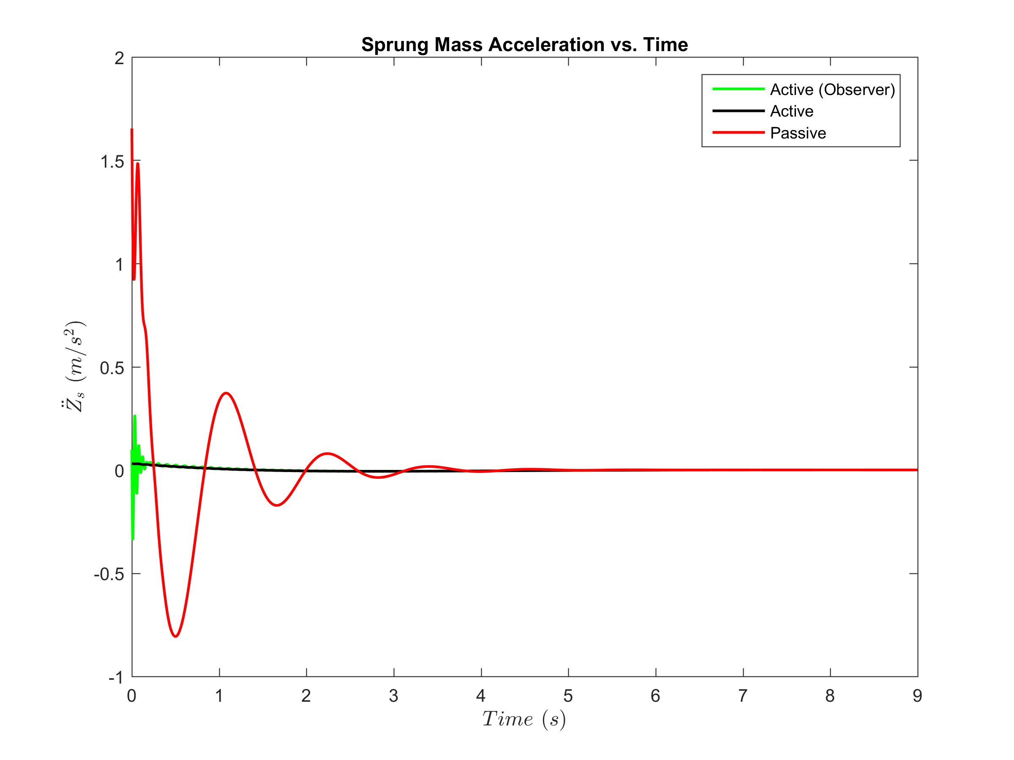
Reduced Order
Closed-loop LQR : Infinite

Slide 32
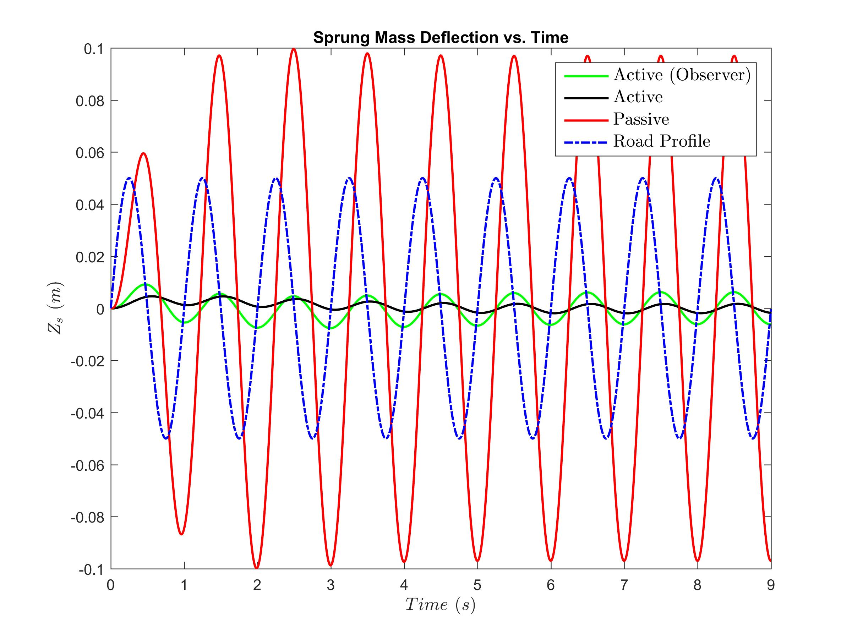
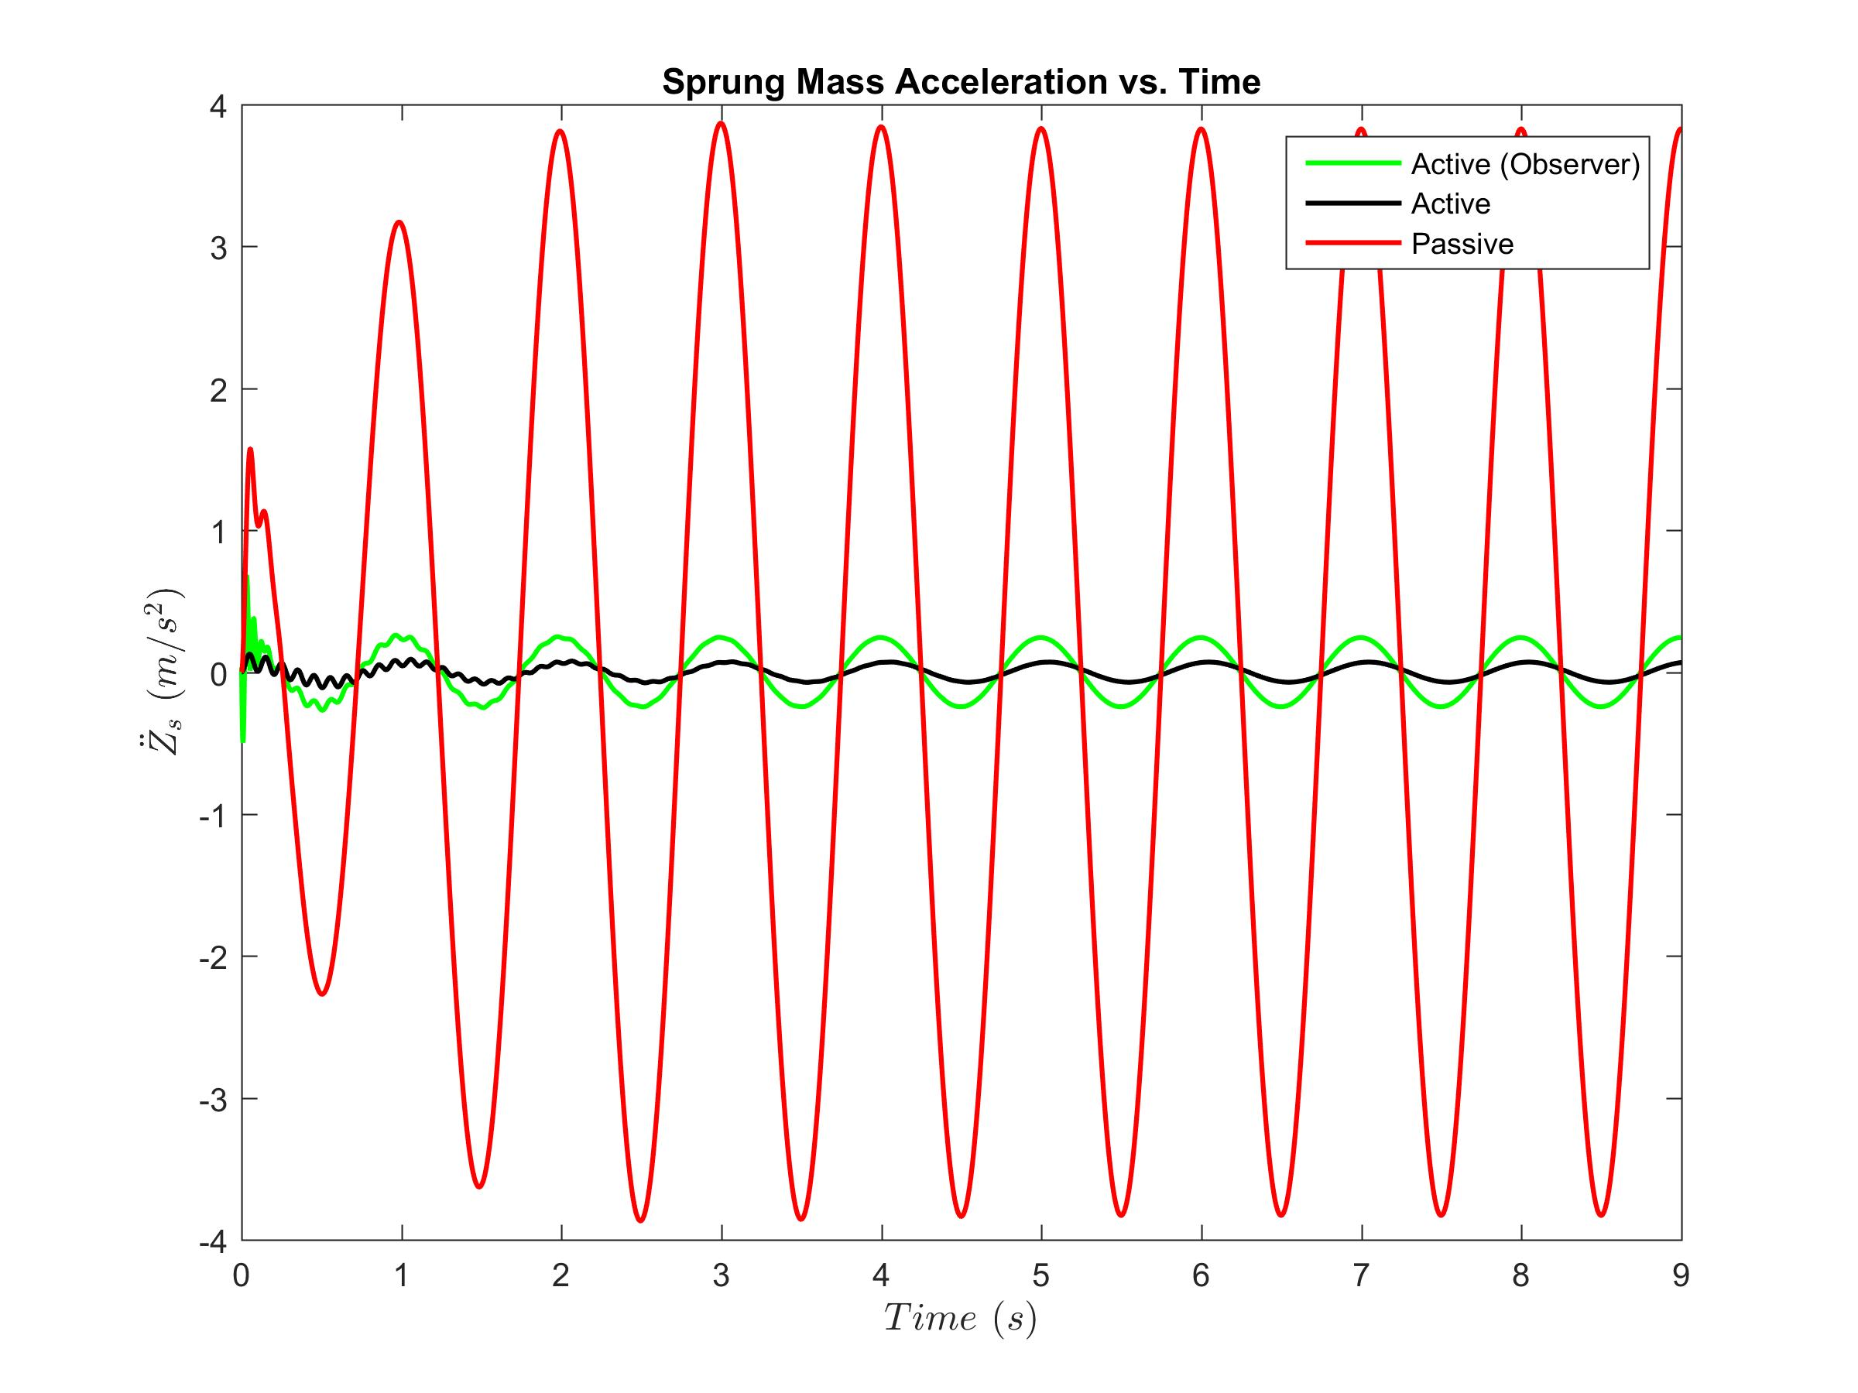
Reduced Order
Closed-loop LQR : Infinite

Slide 33
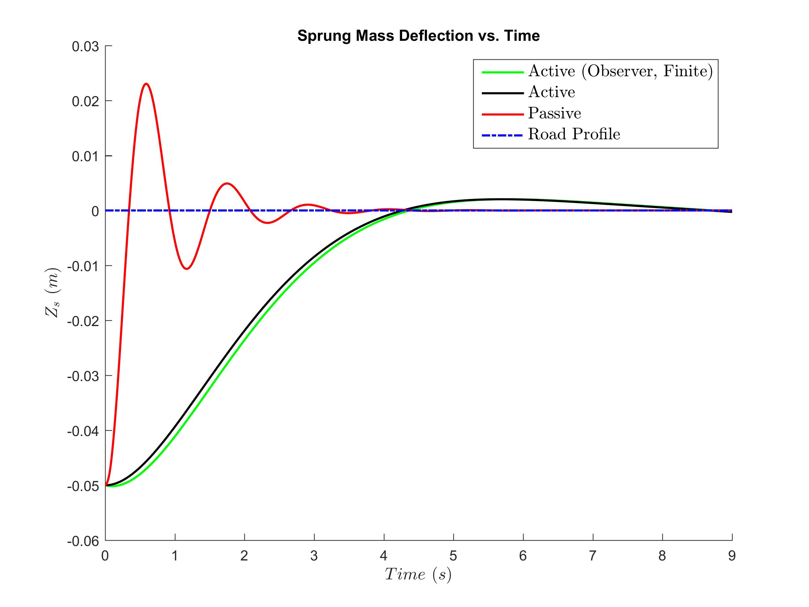
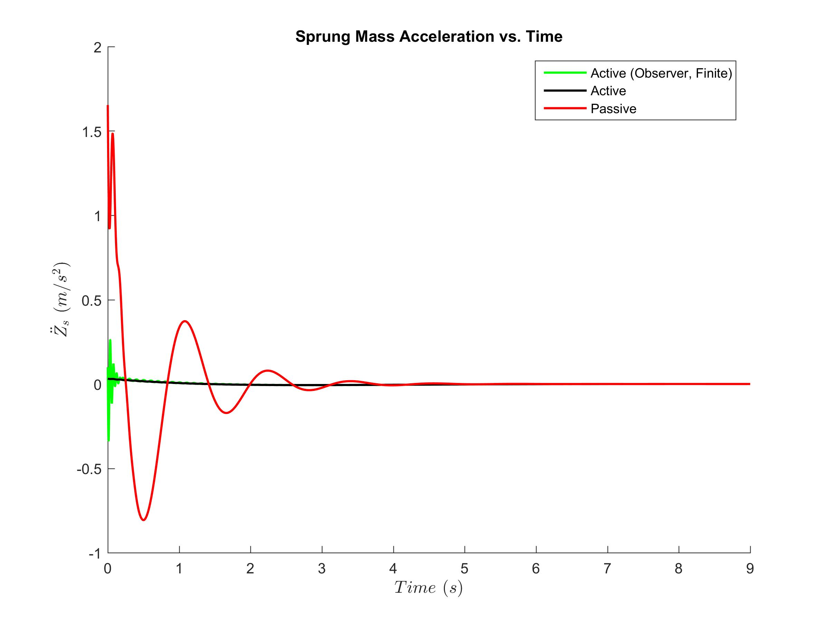
Reduced Order
Closed-loop LQR : Finite time

Slide 34
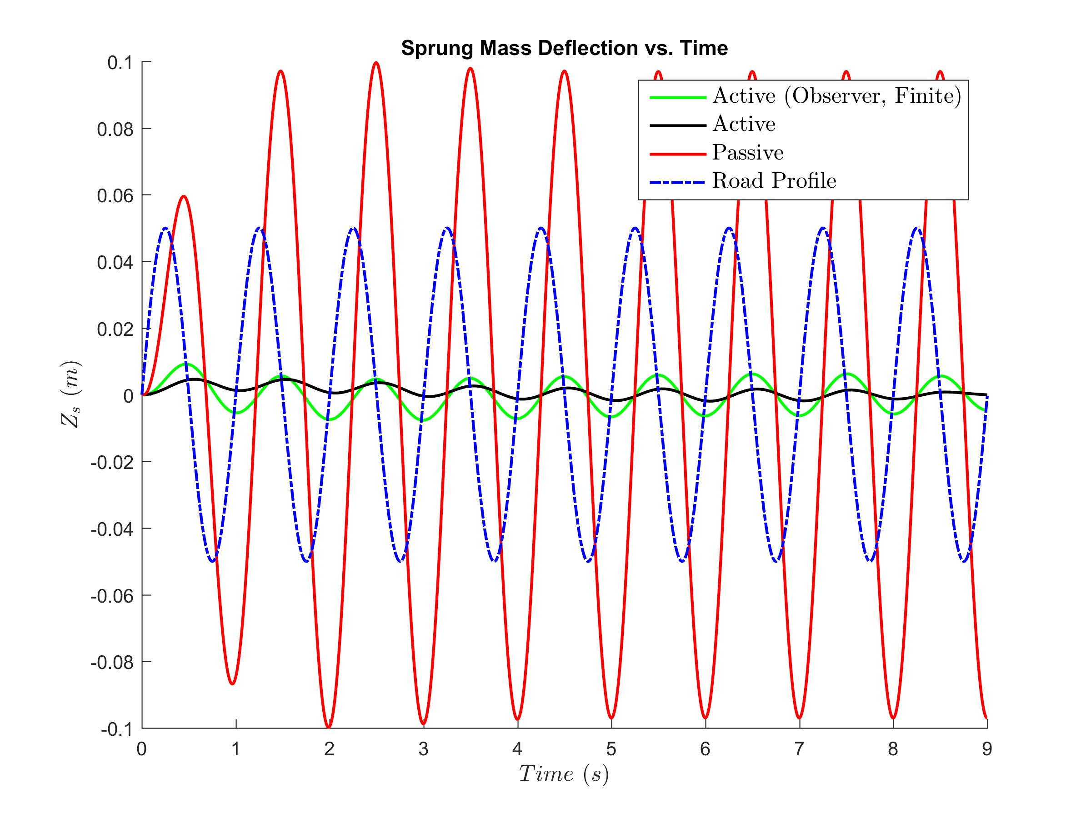
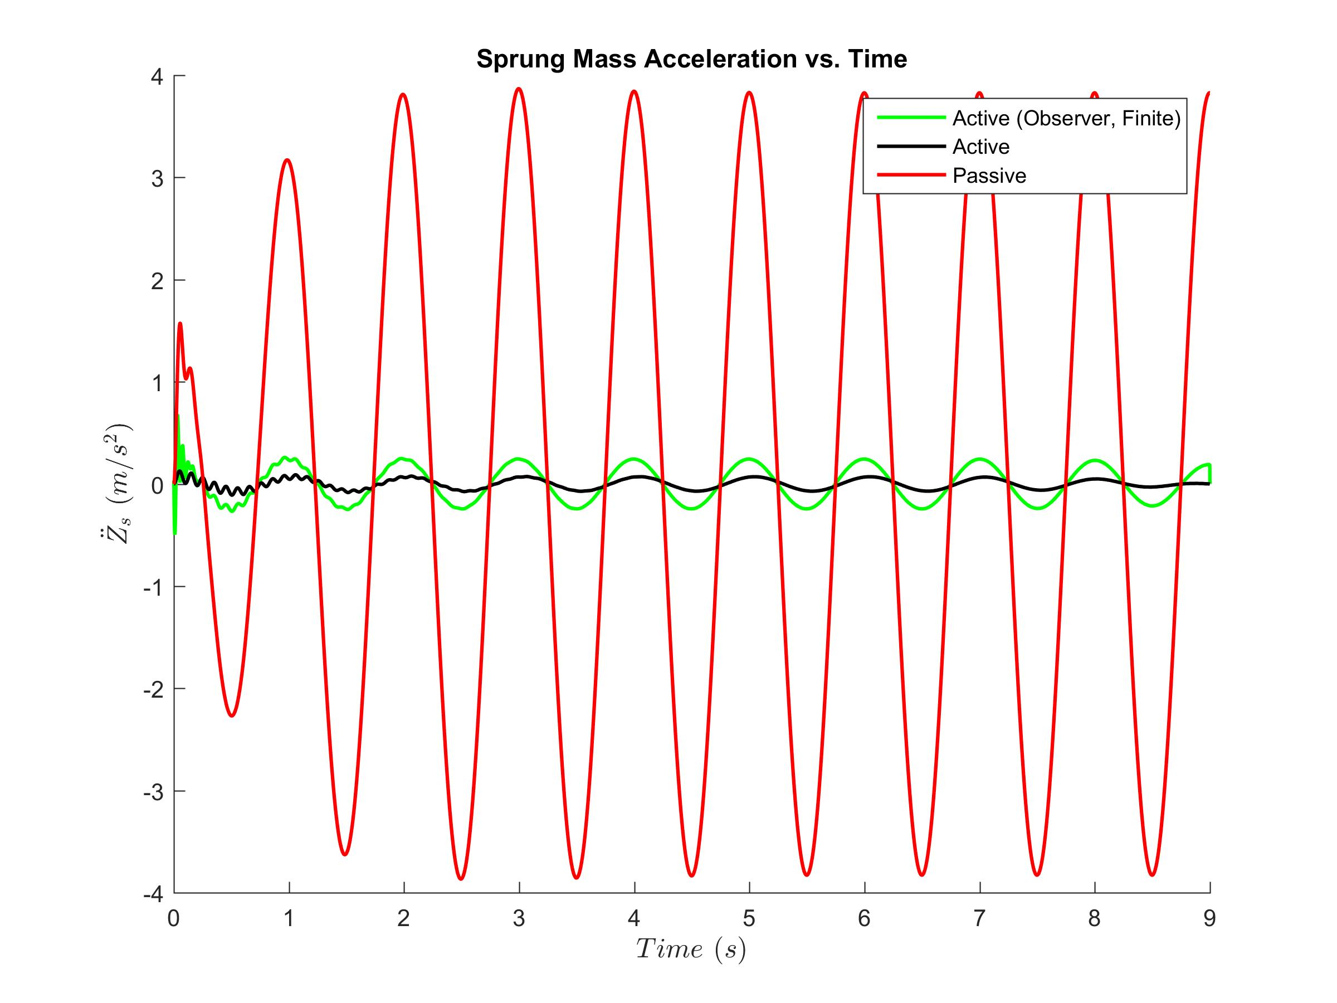
Reduced Order
Closed-loop LQR : Finite time

Slide 35
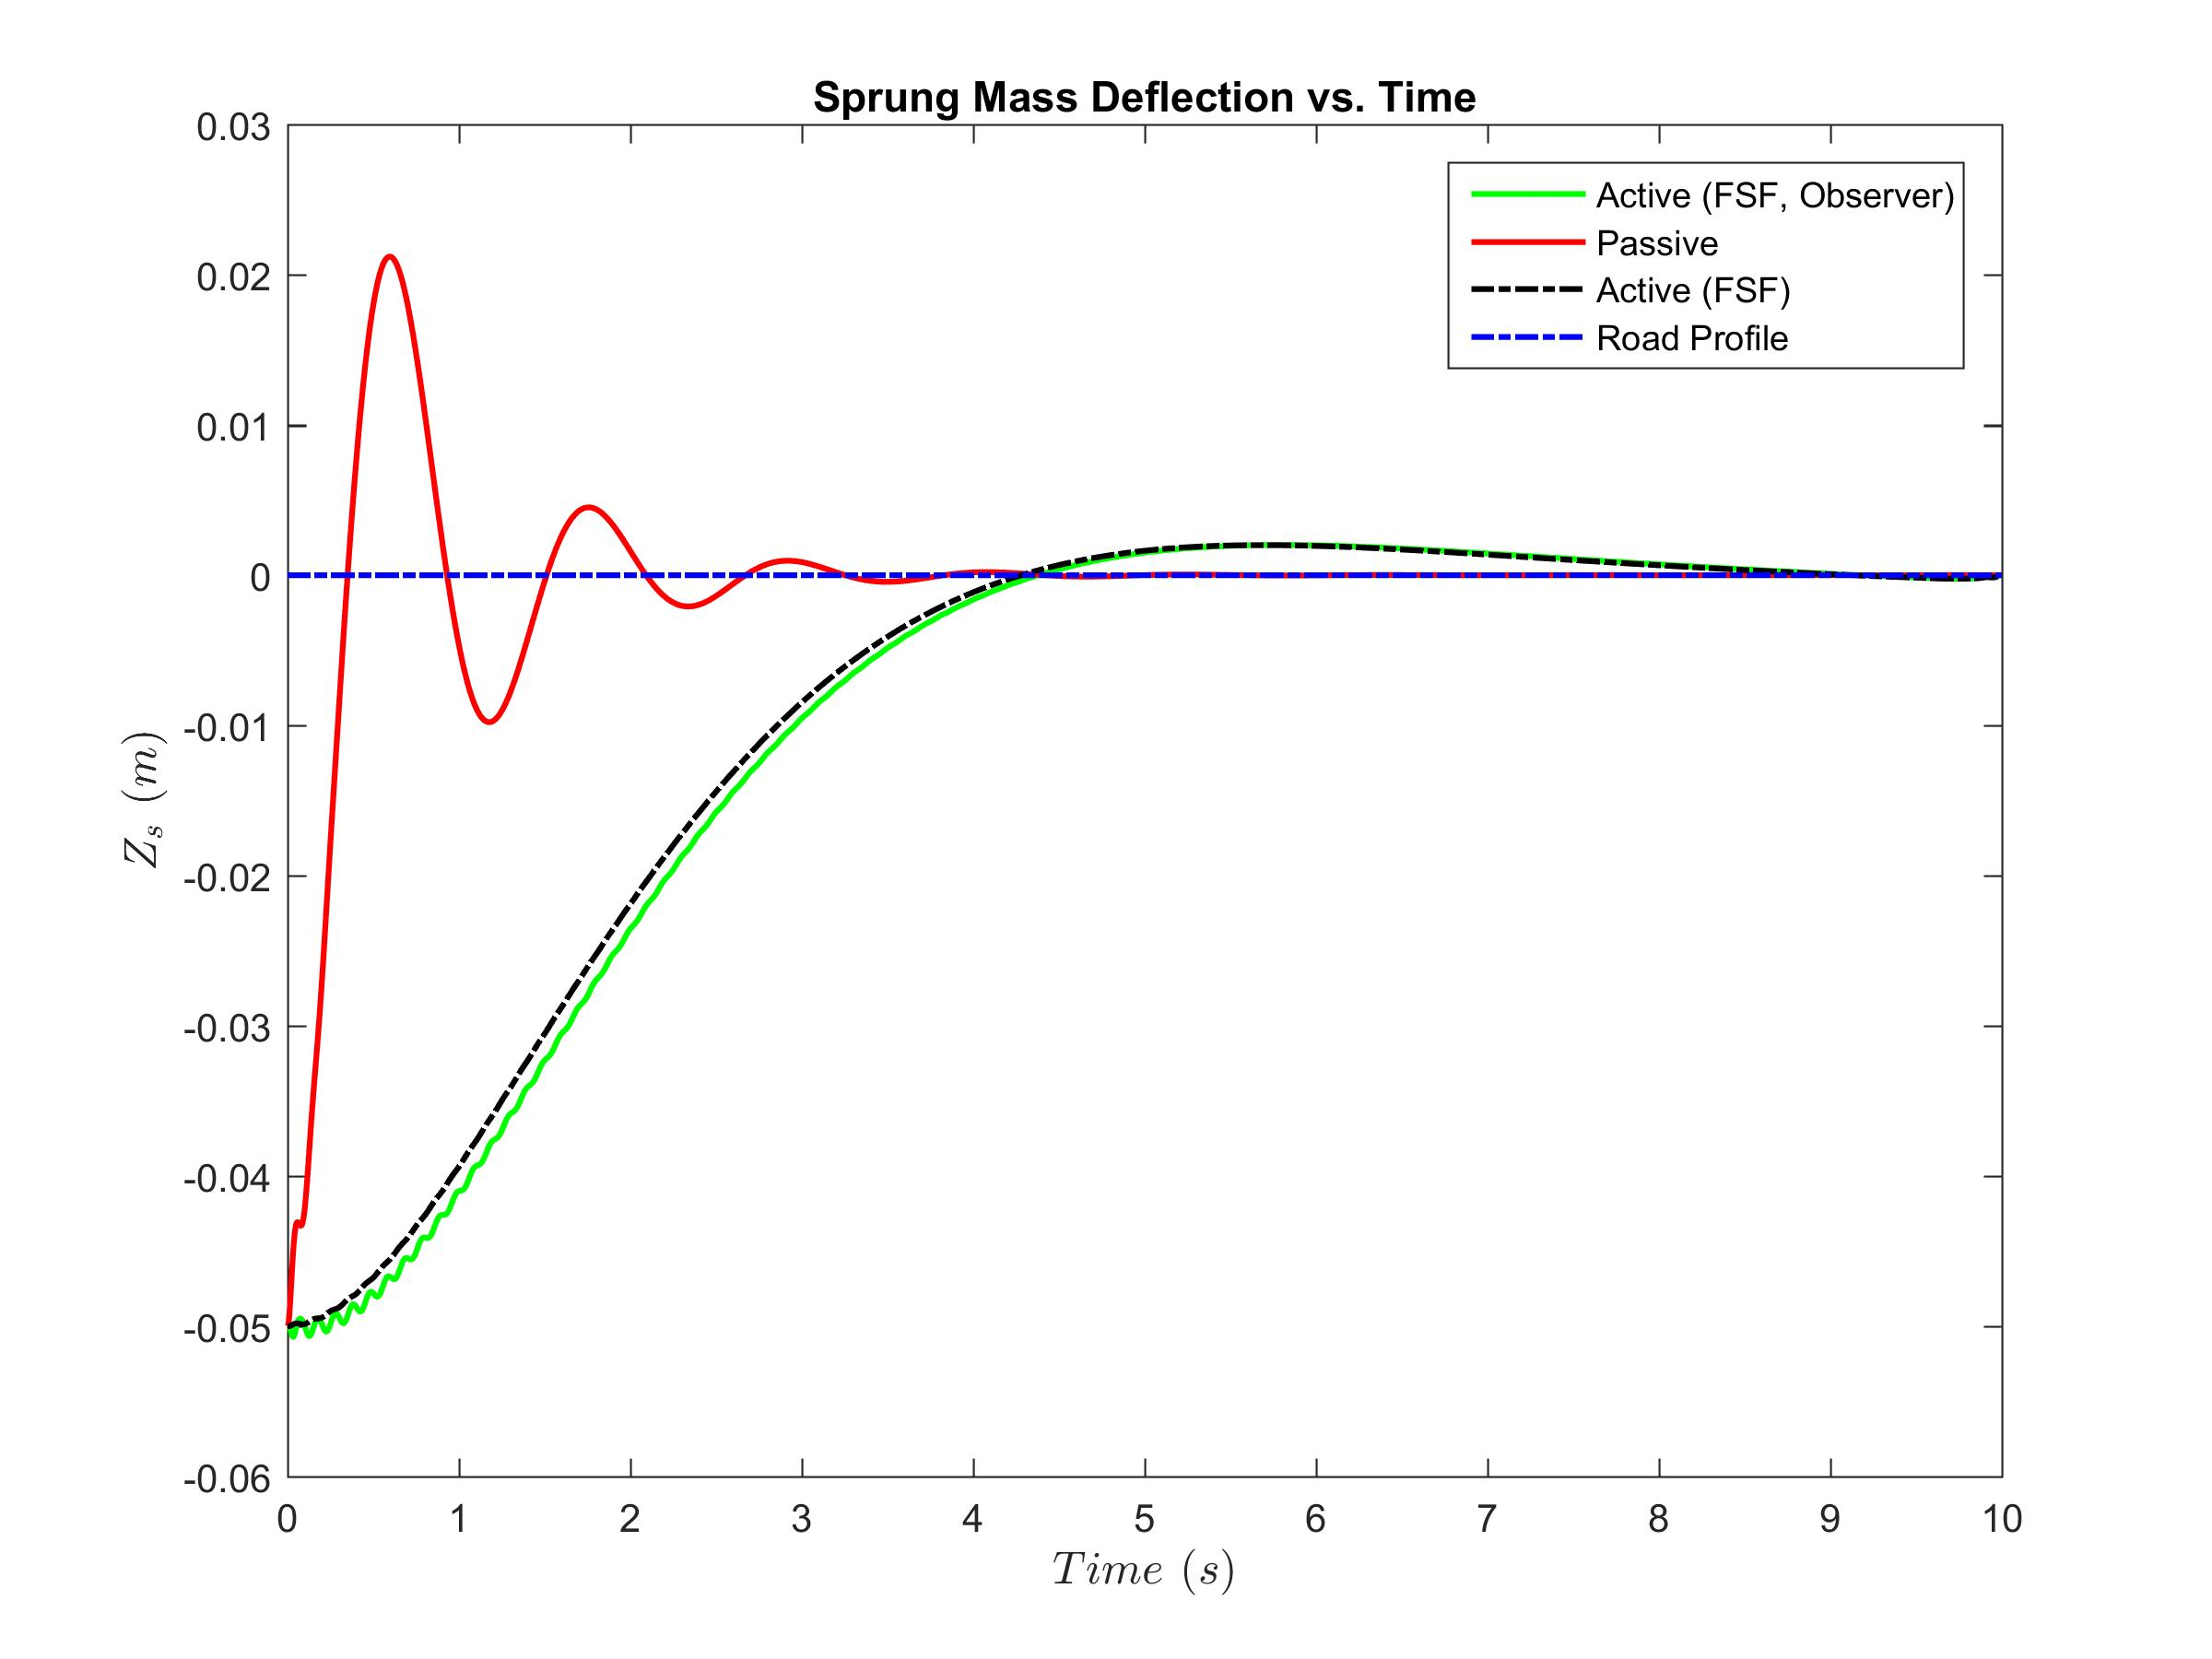
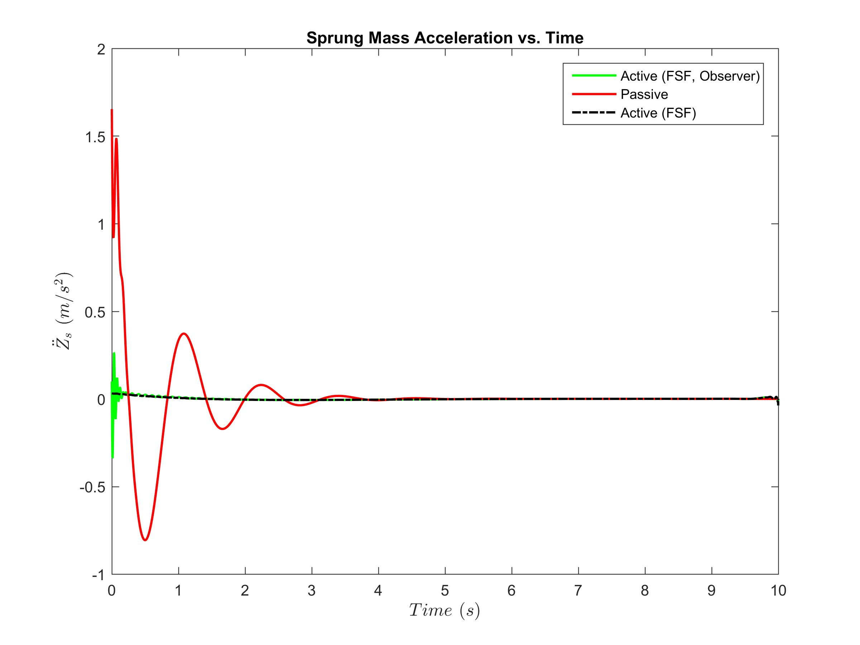
Reduced Order
Closed-loop LQR : Final State Fixed Finite time

Slide 36
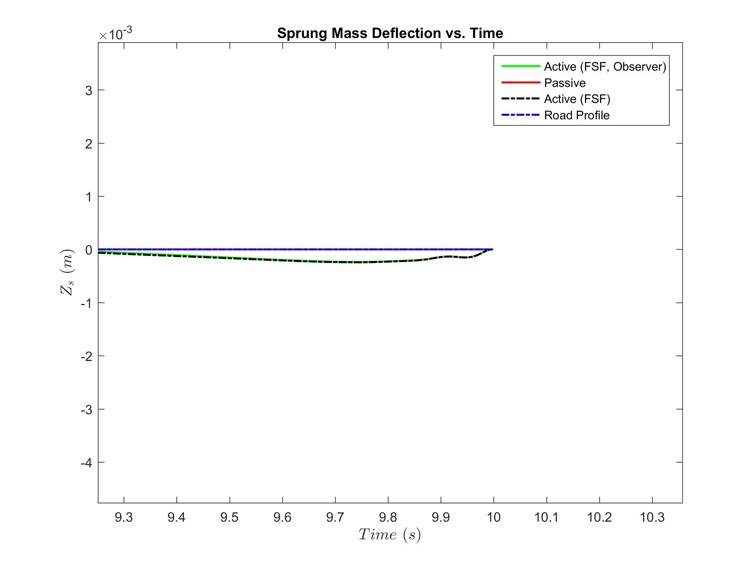
Reduced Order
Closed-loop LQR : Final State Fixed Finite time

Slide 37
Thank You!
Questions?

